Slide 1
Statistics for Business and Economics
Inferences Based on a Single Sample: Tests of Hypothesis Chapter 7

Slide 2
Learning Objectives
1. Distinguish Types of Hypotheses
2. Describe Hypothesis Testing Process
3. Explain p-Value Concept
4. Solve Hypothesis Testing Problems Based on a Single Sample
5. Explain Power of a Test
Notes:
As a result of this class, you will be able to ...

Slide 3
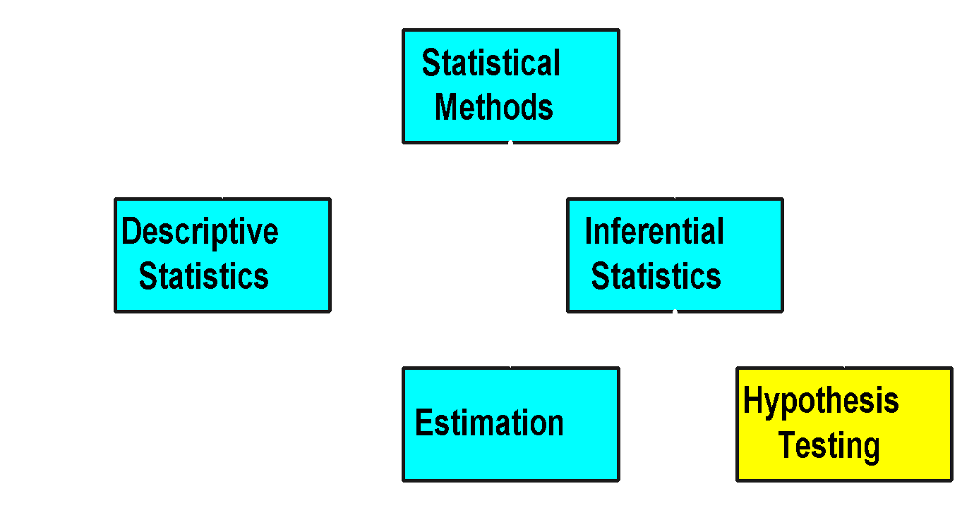
Statistical Methods
Notes:
5

Slide 4
Hypothesis Testing Concepts
Notes:
9

Slide 5
Hypothesis Testing

Slide 6
Hypothesis Testing
Population
☺
☺
☺
☺
☺
☺
☺

Slide 7

Hypothesis Testing
I believe the population mean age is 50 (hypothesis).
Population
☺
☺
☺
☺
☺
☺
☺

Slide 8
Hypothesis Testing
I believe the population mean age is 50 (hypothesis).
Population
☺
☺
☺
☺
☺
☺
Random sample
☺
Mean X = 20
☺
☺

Slide 9

Hypothesis Testing
I believe the population mean age is 50 (hypothesis).
Reject hypothesis! Not close.
Population
☺
☺
☺
☺
☺
☺
Random sample
☺
Mean X = 20
☺
☺

Slide 10
Basic Idea

Slide 11
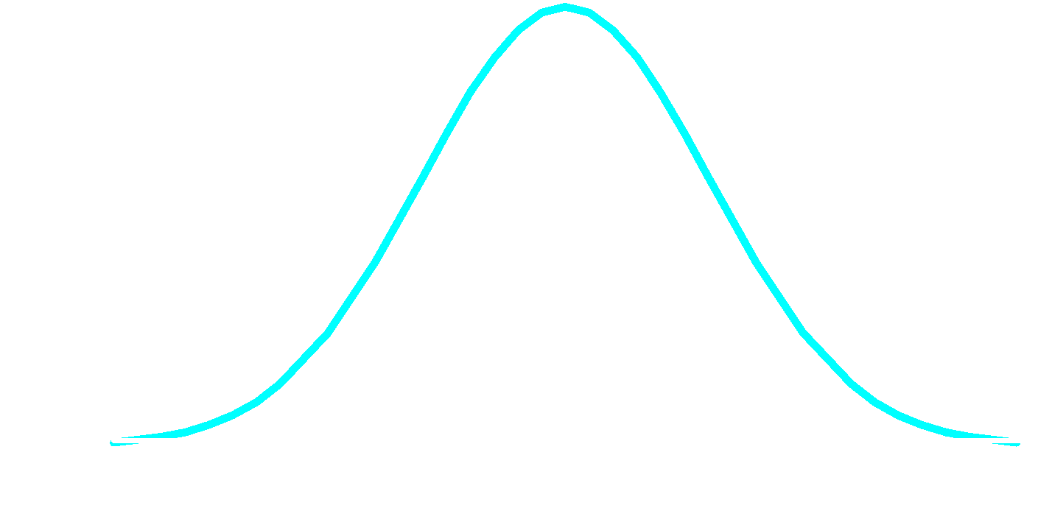
Basic Idea
Sampling Distribution
H₀

Slide 12
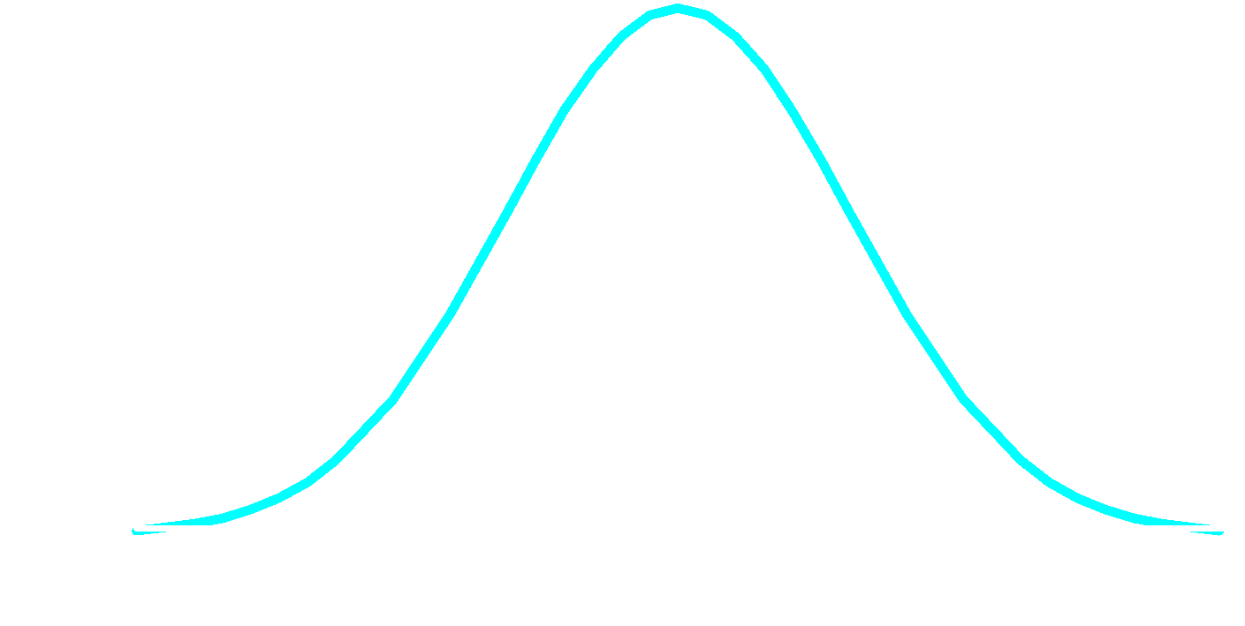
Basic Idea
Sampling Distribution
It is unlikely that we would get a sample mean of this value ...
20
H₀

Slide 13
Basic Idea
Sampling Distribution
It is unlikely that we would get a sample mean of this value ...
... if in fact this were the population mean
20
H₀

Slide 14
Basic Idea
Sampling Distribution
It is unlikely that we would get a sample mean of this value ...
... therefore, we reject the hypothesis that μ = 50.
... if in fact this were the population mean
20
H₀

Slide 15

Hypothesis Testing
I believe the population mean age is 50 (hypothesis).
Fail to reject hypothesis! Its close.
Population
☺
☺
☺
☺
☺
☺
Random sample
☺
Mean X = 49.5
☺
☺

Slide 16
Basic Idea

Slide 17
Basic Idea
Sampling Distribution
H₀

Slide 18
Basic Idea
Sampling Distribution
It is likely that we would get a sample mean of this value ...
49.5
H₀

Slide 19
Basic Idea
Sampling Distribution
It is likely that we would get a sample mean of this value ...
... if in fact this were the population mean
49.5
H₀

Slide 20
Basic Idea
Sampling Distribution
... therefore, we fail to reject the hypothesis that μ = 50.
It is likely that we would get a sample mean of this value ...
... if in fact this were the population mean
49.5
H₀

Slide 21

What’s a Hypothesis?
1. A Belief about a Population Parameter
Parameter Is Population Mean, Proportion, Variance
Must Be Stated Before Analysis
I believe the mean CPI of this class is 9!
© 1984-1994 T/Maker Co.

Slide 22

What’s a Hypothesis?
A Belief about a Population Parameter
Parameter Is Population Mean, Proportion, Variance
Must Be Stated Before Analysis
I believe the mean CGPA of this class is 8.5!
© 1984-1994 T/Maker Co.

Slide 23
Hypothesis Statement
“If I…(do this to an independent variable)….then (this will happen to the dependent variable).”
Example:
If I (decrease amount of water given to herbs) then (herbs will increase in size).
If I (give patients counseling in addition to medication) then (their overall depression scale will decrease).
If I (give exams at noon instead of 7) then (student test scores will improve).

Slide 24
Hypothesis Statement
If then statement is used
Include both independent and dependent variables
It can be tested by experiment, survey or other techniques
It is based on information/research

Slide 25
Hypothesis Testing
Properties :
Should be precise and clear
Should be capable enough for testing
Should be limited in scope and very specific
Should be written in simple words, understandable to all
Should be consistent with all known facts
Should be tested in reasonable time

Slide 26
Null Hypothesis
1. What Is Tested
2. Has Serious Outcome If Incorrect Decision Made
3. Always Has Equality Sign: =, ≤, or ≥
4. Designated H₀
5. Specified as H₀: μ = Some Numeric Value
Specified with = Sign Even if ≤, or ≥
Example, H₀: μ = 3

Slide 27
Alternative Hypothesis
1. Opposite of Null Hypothesis
2. Always Has Inequality Sign: ≠, <, or >
3. Designated H_{a}
4. Specified H_{a}: μ < Some Value
Example, H_{a}: μ < 3

Slide 28
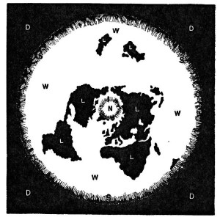
Null hypothesis, H₀: The world is flat. Alternate hypothesis: The world is round. Several scientists, including Copernicus, set out to disprove the null hypothesis. This eventually led to the rejection of the null and the acceptance of the alternate. Most people accepted it — the ones that didn’t created the Flat Earth Society!. What would have happened if Copernicus had not disproved it and merely proved the alternate? No one would have listened to him. In order to change people’s thinking, he first had to prove that their thinking was wrong.
Not so long ago, people believed that the world was flat.
Notes:
Why Do I need to Test it? Why not just prove an alternate one?
making sure than any new hypothesis has no flaws. Including both a null and an alternate hypothesis is one safeguard to ensure your research isn’t flawed.

Slide 29
Identifying Hypotheses Steps
1. Example Problem: Test That the Population Mean Is Not 3
2. Steps
State the Question Statistically (μ ≠ 3)
State the Opposite Statistically (μ = 3)
Must Be Mutually Exclusive & Exhaustive
Select the Alternative Hypothesis (μ ≠ 3)
Has the ≠, <, or > Sign
State the Null Hypothesis (μ = 3)

Slide 30
What Are the Hypotheses?
Is the population average amount of TV viewing 12 hours?
State the question statistically: μ = 12
State the opposite statistically: μ ≠ 12
Select the alternative hypothesis: H_{a}: μ ≠ 12
State the null hypothesis: H₀: μ = 12

Slide 31
What Are the Hypotheses?
Is the population average amount of TV viewing different from 12 hours?
State the question statistically: μ ≠ 12
State the opposite statistically: μ = 12
Select the alternative hypothesis: H_{a}: μ ≠ 12
State the null hypothesis: H₀: μ = 12

Slide 32
What Are the Hypotheses?
Is the average cost per hat less than or equal to $20?
State the question statistically: μ ≤ 20
State the opposite statistically: μ > 20
Select the alternative hypothesis: H_{a}: μ > 20
State the null hypothesis: H₀: μ = 20

Slide 33
What Are the Hypotheses?
Is the average amount spent in the bookstore greater than $25?
State the question statistically: μ > 25
State the opposite statistically: μ ≤ 25
Select the alternative hypothesis: H_{a}: μ > 25
State the null hypothesis: H₀: μ = 25

Slide 34

Hypothesis Testing - Example 1
A researcher is studying the effects of radical exercise program on knee surgery patients. There is a good chance the therapy will improve recovery time, but there’s also the possibility it will make it worse. Average recovery times for knee surgery patients is 8.2 weeks
Notes:
You’ll be asked to convert a word problem into a hypothesis statement in statistics that will include a null hypothesis and an alternate hypothesis. Breaking your problem into a few small steps makes these problems much easier to handle.
Example Problem: A researcher thinks that if knee surgery patients go to physical therapy twice a week (instead of 3 times), their recovery period will be longer. Average recovery times for knee surgery patients is 8.2 weeks.

Slide 35
Hypothesis Testing - Example 1
H0: μ = 8.2
Ha: μ ≠ 8.2
Notes:
Step 1: State what will happen if the experiment doesn’t make any difference. That’s the null hypothesis–that nothing will happen. In this experiment, if nothing happens, then the recovery time will stay at 8.2 weeks.
H₀: μ = 8.2
Broken down into English, that’s H₀ (The null hypothesis): μ (the average) = (is equal to) 8.2
Step 2: Figure out the alternate hypothesis. The alternate hypothesis is the opposite of the null hypothesis. In other words, what happens if our experiment makes a difference?
H₁: μ ≠ 8.2
In English again, that’s H₁ (The alternate hypothesis): μ (the average) ≠ (is not equal to) 8.2
That’s How to State the Null Hypothesis!

Slide 36
Hypothesis Testing - Example 2
A researcher thinks that if knee surgery patients go to physical therapy twice a week (instead of 3 times), their recovery period will be longer. Average recovery times for knee surgery patients is 8.2 weeks.
Notes:
You’ll be asked to convert a word problem into a hypothesis statement in statistics that will include a null hypothesis and an alternate hypothesis. Breaking your problem into a few small steps makes these problems much easier to handle.
Example Problem: A researcher thinks that if knee surgery patients go to physical therapy twice a week (instead of 3 times), their recovery period will be longer. Average recovery times for knee surgery patients is 8.2 weeks.
Step 1: Figure out the hypothesis from the problem. The hypothesis is usually hidden in a word problem, and is sometimes a statement of what you expect to happen in the experiment. The hypothesis in the above question is “I expect the average recovery period to be greater than 8.2 weeks.”
Step 2: Convert the hypothesis to math. Remember that the average is written as μ.
H₁: μ > 8.2
Broken down into (somewhat) English, that’s H₁ (The hypothesis): μ (the average) > (is greater than) 8.2
Step 3: State what will happen if the hypothesis doesn’t come true. If the recovery time isn’t greater than 8.2 weeks, there are only two possibilities, that the recovery time is equal to 8.2 weeks or less than 8.2 weeks.
H₀: μ ≤ 8.2
Broken down again into English, that’s H₀ (The null hypothesis): μ (the average) ≤ (is less than or equal to) 8.2

Slide 37
Hypothesis Testing - Example 2
H0: μ <= 8.2
Ha: μ > 8.2

Slide 38
Example
A study suggests that the average college student spends about 2 hours per week communicating with others online. You believe that this is an underestimate and decide to collect your own sample for the hypothesis test. You randomly sample 60 students from your Institute and find that on average, they spend 3.5 hours a week communicating with others online. What are the appropriate hypothesis?
Ho: X = 2 Hrs. / wk ; Ha : X > 2 Hrs. / wk
Ho: X = 2 Hrs. / wk ; Ha : X > 3.5 Hrs. / wk
Ho: μ = 2 Hrs. / wk ; Ha : μ != 2 Hrs. / wk
Ho: μ = 2 Hrs. / wk
Notes:
Ans. ‘c’

Slide 39

Example
Chain restaurants have been required to display calorie count of each menu item. Prior to displaying calorie counts, the average calorie intake of diners at a restaurant was 1100 calories. After calorie counts started to be displayed on menus, a nutritionist collected data on the number of calories consumed at this restaurant from a random sample of diners. Which of the following would be used to test whether there was evidence of a difference in the average calorie intake of diners at this restaurant?
Ho: x = 1100 calories; Ha: x ≠ 1100 calories
Ho: x = 1100 calories; Ha: x < 1100 calories
Ho: μ = 1100 calories; Ha: μ ≠ 1100 calories
Ho: μ < 1100 calories; Ha: μ > 1100 calories
Ans. ‘c’

Slide 40
Level of Significance
1. Probability
2. Defines Unlikely Values of Sample Statistic if Null Hypothesis Is True
Called Rejection Region of Sampling Distribution
3. Designated α (alpha)
Typical Values Are .01, .05, .10
4. Selected by Researcher at Start

Slide 41
Rejection Region (One-Tail Test)
Notes:
Rejection region does NOT include critical value.

Slide 42
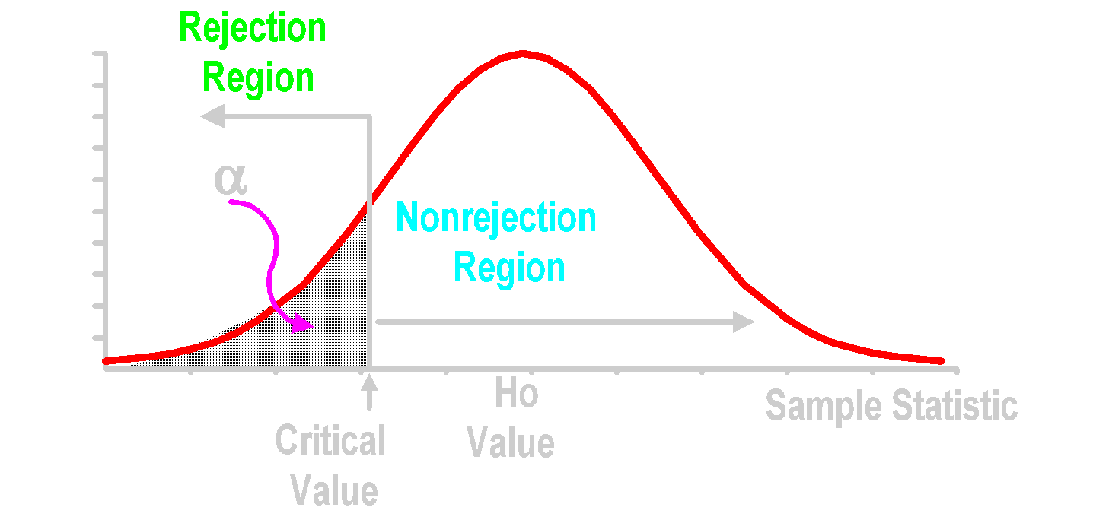
Rejection Region (One-Tail Test)
Sampling Distribution
Level of Confidence
1 - α
Notes:
Rejection region does NOT include critical value.

Slide 43

Rejection Region (One-Tail Test)
Sampling Distribution
Level of Confidence
1 - α
Observed sample statistic
Notes:
Rejection region does NOT include critical value.

Slide 44

Rejection Region (One-Tail Test)
Sampling Distribution
Level of Confidence
1 - α
Notes:
Rejection region does NOT include critical value.

Slide 45
Rejection Regions (Two-Tailed Test)
Notes:
Rejection region does NOT include critical value.

Slide 46
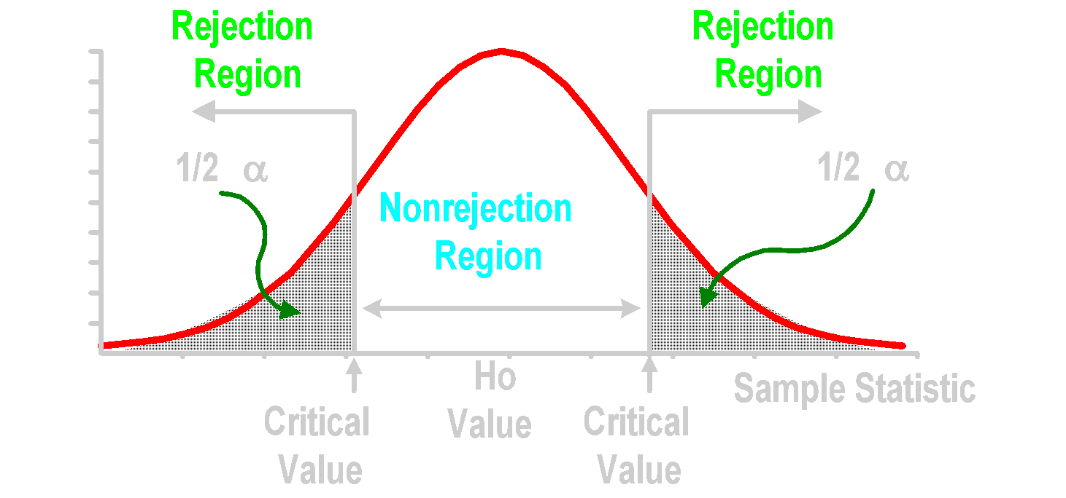
Rejection Regions (Two-Tailed Test)
Sampling Distribution
Level of Confidence
1 - α
Notes:
Rejection region does NOT include critical value.

Slide 47

Rejection Regions (Two-Tailed Test)
Sampling Distribution
Level of Confidence
1 - α
Observed sample statistic
Notes:
Rejection region does NOT include critical value.

Slide 48

Rejection Regions (Two-Tailed Test)
Sampling Distribution
Level of Confidence
1 - α
Notes:
Rejection region does NOT include critical value.

Slide 49
Rejection Regions (Two-Tailed Test)
Sampling Distribution
Level of Confidence
1 - α
Notes:
Rejection region does NOT include critical value.

Slide 50
Decision Making Risks Type I & Type II Errors
Notes:
9

Slide 51
Errors in Making Decision
1. Type I Error
Reject True Null Hypothesis
Has Serious Consequences
Probability of Type I Error Is α (Alpha)
Called Level of Significance
2. Type II Error
Do Not Reject False Null Hypothesis
Probability of Type II Error Is β (Beta)

Slide 52
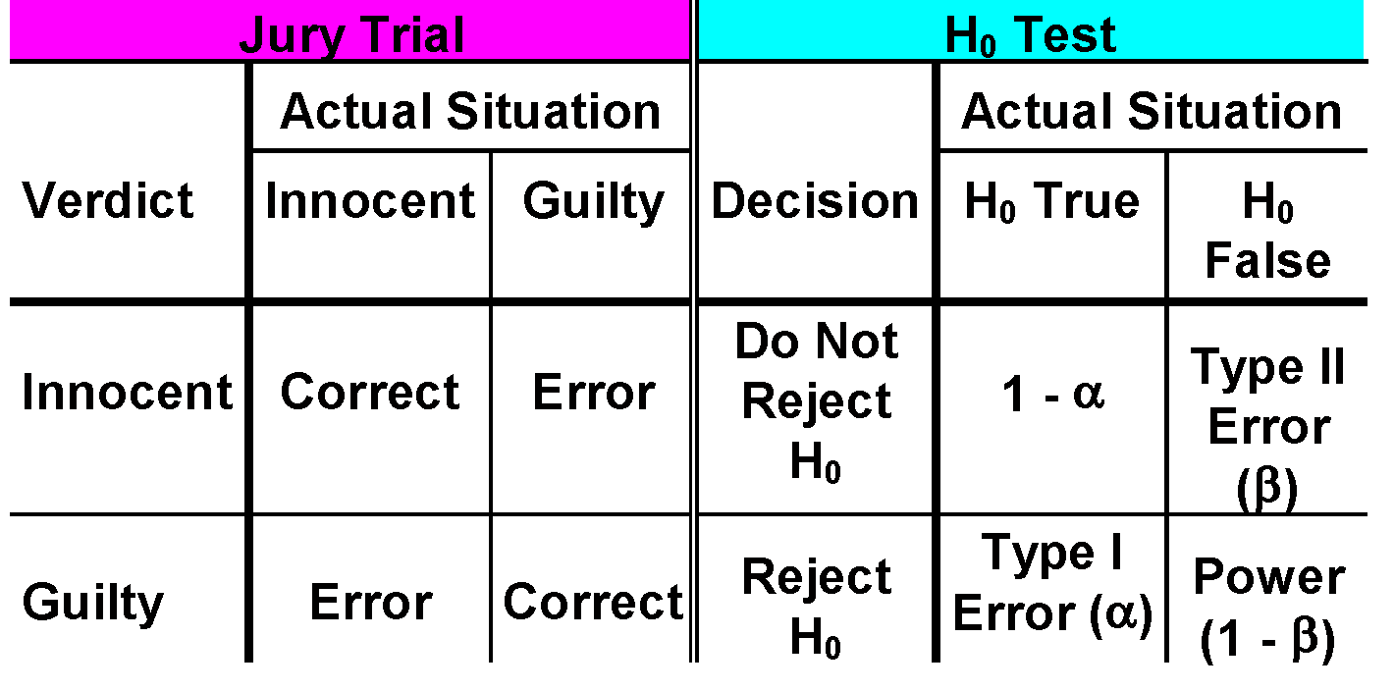
Decision Results
H₀: Innocent

Slide 53
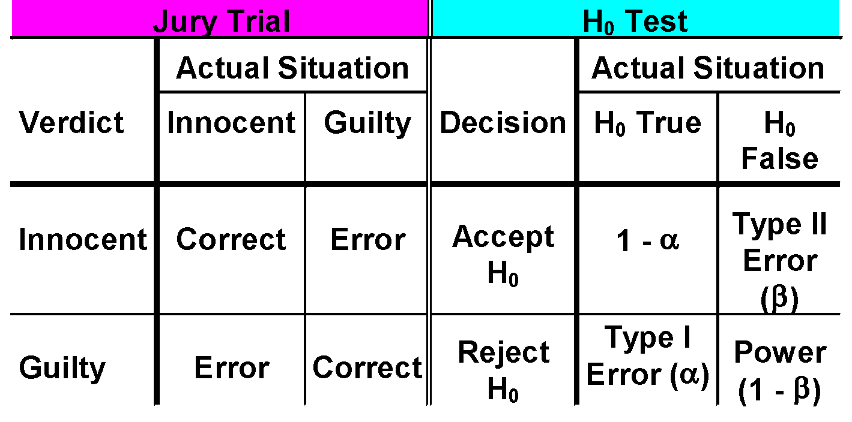
Decision Results
H₀: Innocent

Slide 54
Jury Trial vs. Hypothesis Test
 | Jury Trial | Hypothesis Test
Assumption
Defendant is
Innocent
Null hypothesis
is true
Standard of Proof
Beyond a
reasonable doubt
Determined by
α
Evidence
Facts presented
at trial
Summary
statistics
Decision
Fail to reject
assumption
(not guilty)
or
reject (guilty)
Fail to reject H₀
or
Reject H₀ in favor
of H_{a}

Slide 55
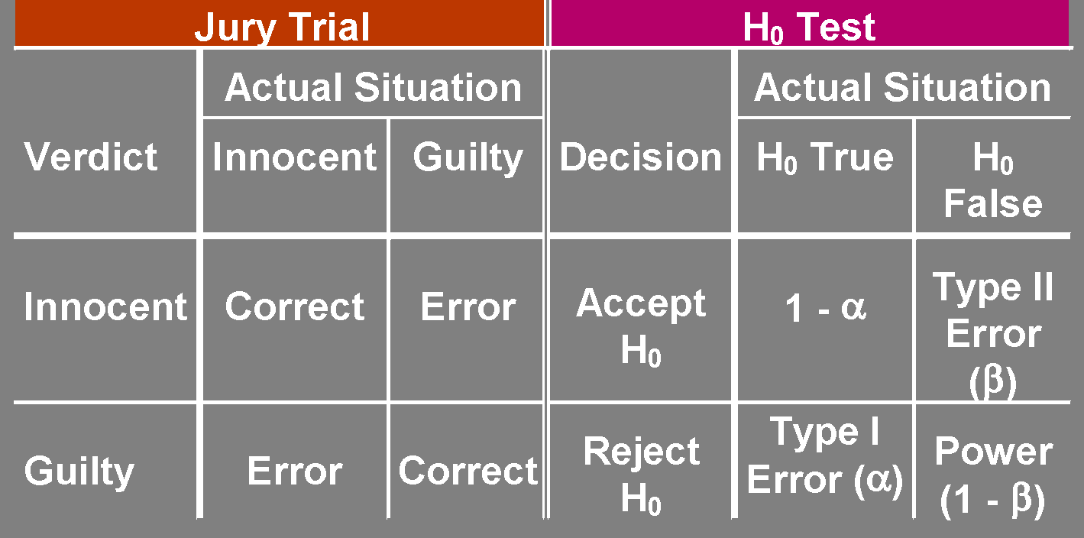
Decision Results
H₀: Innocent

Slide 56
Example
A food safety inspector is called upon to investigate a restaurant, with a few customer reports of poor sanitation practices. The inspector uses a hypothesis testing framework to evaluate whether the regulations are met or not. The inspector’s hypothesis are –
Ho: restaurant meets food and safety regulations;
Ha: restaurant does not meet food and safety regulations.
If the inspector concludes that the restaurant does not meets the regulations and the restaurant is closed, when the restaurant is actually safe, what type of error is made?
Notes:
Ans. Type 1

Slide 57
Example
A food safety inspector is called upon to investigate a restaurant, with a few customer reports of poor sanitation practices. The inspector uses a hypothesis testing framework to evaluate whether the regulations are met or not. The inspector’s hypothesis are –
Ho: restaurant meets food and safety regulations;
Ha: restaurant does not meet food and safety regulations.
If the inspector concludes that the restaurant meets the regulations and the restaurant stays open, when the restaurant is actually not safe, what type of error is made?
Notes:
Ans. Type 2

Slide 58
Context?
What does it mean to make a type I error?
Convict an innocent person of a crime.
Close a safe restaurant
What does it mean to make a type II error?
Fail to convict a guilty person.
Allow unsafe restaurant to be open
What do we usually say about type I and type II error rates in this context?

Slide 59
Scenarios
A particular compound is not hazardous in drinking water if it is present at a rate of no more than 25ppm. A watchdog group believes that a certain water source does not meet this standard.
μ: mean amount of the compound (in ppm)
H₀: μ < 25
H_{a}: μ > 25
If the watchdog group decides to gather data and formally conduct this test, describe type I and type II errors in the context of this scenario and the consequences of each.

Slide 60
Scenarios
Type I error:
Stating that the evidence indicates the water is unsafe when, in fact, it is safe.
The watchdog group will have potentially initiated a clean-up where none was required ($$ wasted).
Type II error:
Stating that there is no evidence that the water is unsafe when, in fact, it is unsafe.
The opportunity to note (and repair) a potential health risk will be missed.

Slide 61
Scenarios
A lobbying group has a been advocating a particular ballot proposal. One week before the election, they are considering moving some of their advertising efforts to other issues. If the proposal has a support level of at least 55%, they will feel it’s “safe” and move money to other campaigns.
p: proportion of people who support the proposal
H₀: p > .55
H_{a}: p < .55
If the lobbying group decides to gather data and formally conduct this test, describe type I and type II errors in the context of this scenario and the consequences of each.

Slide 62
Scenarios
Type I error:
Stating that the evidence indicates the support level is less than 55% (and the proposal may be in jeopardy of failing) when that is not the case.
The lobbying group will have kept advertising dollars aimed at this proposal when they could have been spent elsewhere.
Type II error:
Stating that the proposal appears to have a “safe” level of support when that is not the case.
The lobbying group would shift funds away from supporting this proposal even though it may still be in need of that support.

Slide 63

α & β Have an Inverse Relationship
You can’t reduce both errors simultaneously!
β
α

Slide 64
Factors Affecting β
1. True Value of Population Parameter
Increases When Difference With Hypothesized Parameter Decreases
2. Significance Level, α
Increases When α Decreases
3. Population Standard Deviation, σ
Increases When σ Increases
4. Sample Size, n
Increases When n Decreases

Slide 65
Hypothesis Testing Steps
Notes:
9

Slide 66
H₀ Testing Steps

Slide 67
H₀ Testing Steps
State H₀
State H_{a}
Choose α
Choose n
Choose test

Slide 68
H₀ Testing Steps
State H₀
State H_{a}
Choose α
Choose n
Choose test
Set up critical values
Collect data
Compute test statistic
Make statistical decision
Express decision

Slide 69
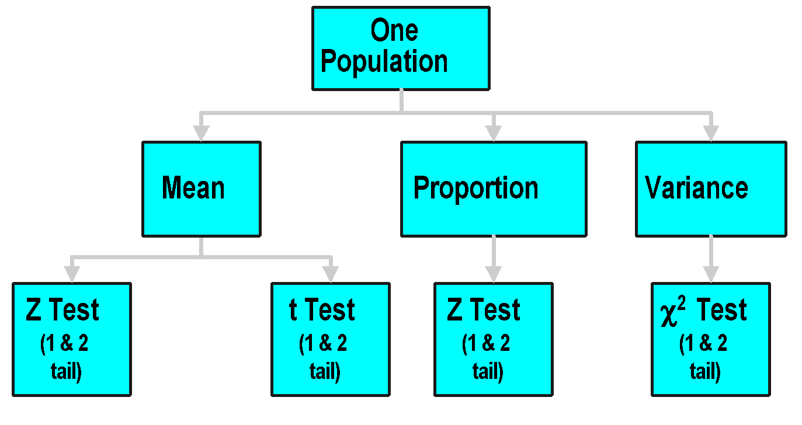
One Population Tests

Slide 70
Two-Tailed Z Test of Mean (σ Known)
Notes:
9

Slide 71
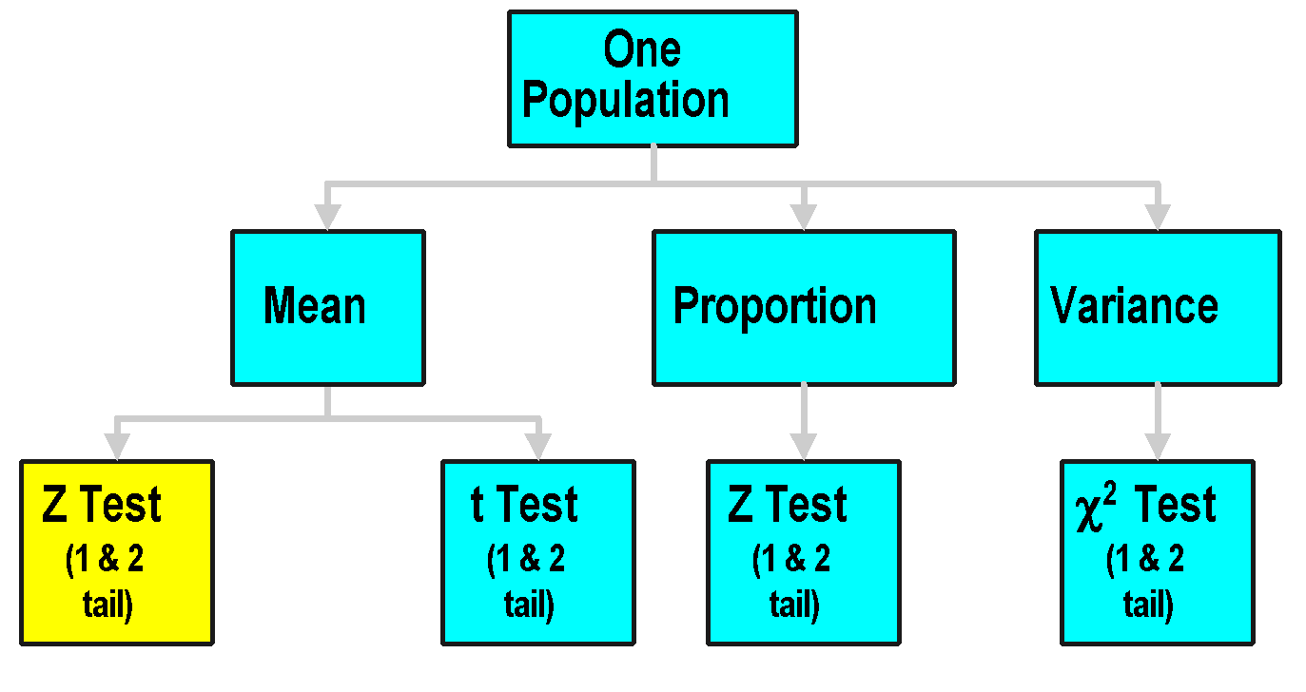
One Population Tests

Slide 72
Two-Tailed Z Test for Mean (σ Known)
1. Assumptions
Population Is Normally Distributed
If Not Normal, Can Be Approximated by Normal Distribution (n ≥ 30)
2. Alternative Hypothesis Has ≠ Sign

Slide 73
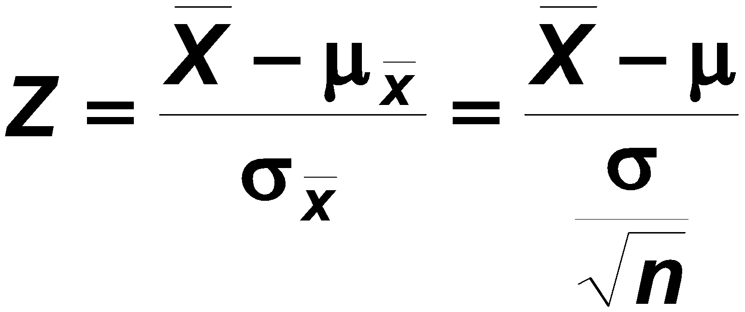
Two-Tailed Z Test for Mean (σ Known)
1. Assumptions
Population Is Normally Distributed
If Not Normal, Can Be Approximated by Normal Distribution (n ≥ 30)
2. Alternative Hypothesis Has ≠ Sign
3. Z-Test Statistic

Slide 74

Two-Tailed Z Test Example
Does an average box of cereal contain 368 grams of cereal? A random sample of 25 boxes showedX = 372.5. The company has specified σ to be 25 grams. Test at the .05 level.
368 gm.

Slide 75
Two-Tailed Z Test Solution
H0:
Ha:
α =
n =
Critical Value(s):
Test Statistic:
Decision:
Conclusion:

Slide 76
Two-Tailed Z Test Solution
H0: μ = 368
Ha: μ ≠ 368
α =
n =
Critical Value(s):
Test Statistic:
Decision:
Conclusion:

Slide 77
Two-Tailed Z Test Solution
H0: μ = 368
Ha: μ ≠ 368
α = .05
n = 25
Critical Value(s):
Test Statistic:
Decision:
Conclusion:

Slide 78
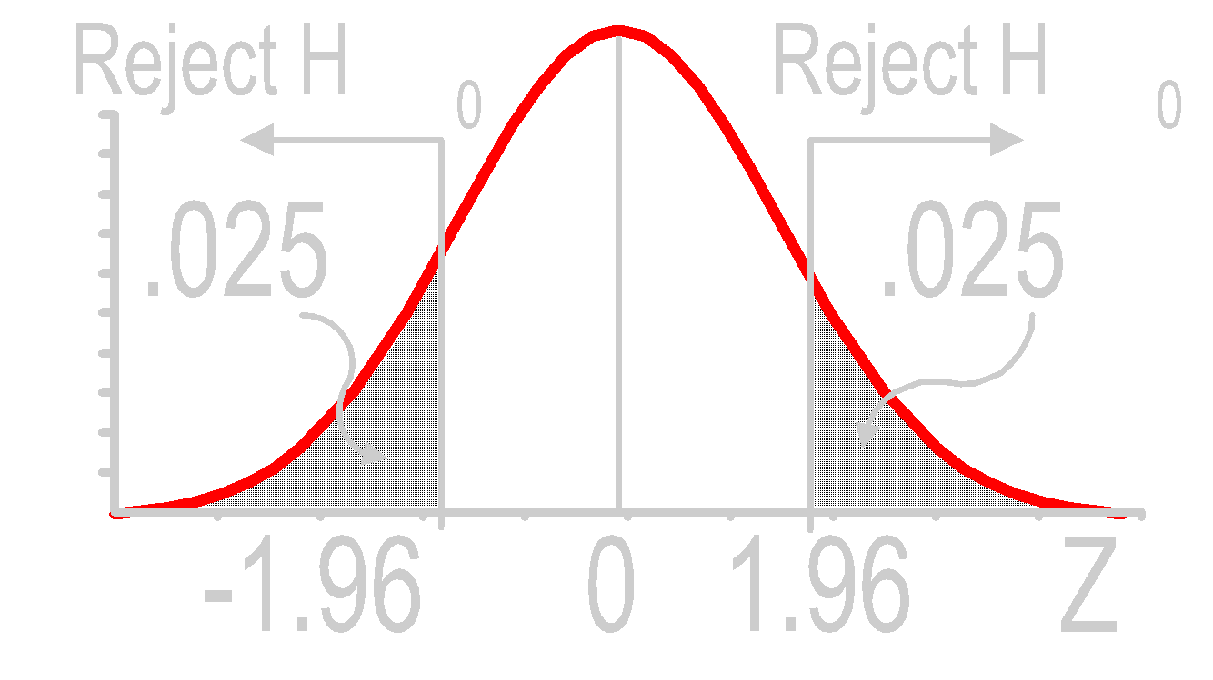
Two-Tailed Z Test Solution
H0: μ = 368
Ha: μ ≠ 368
α = .05
n = 25
Critical Value(s):
Test Statistic:
Decision:
Conclusion:

Slide 79
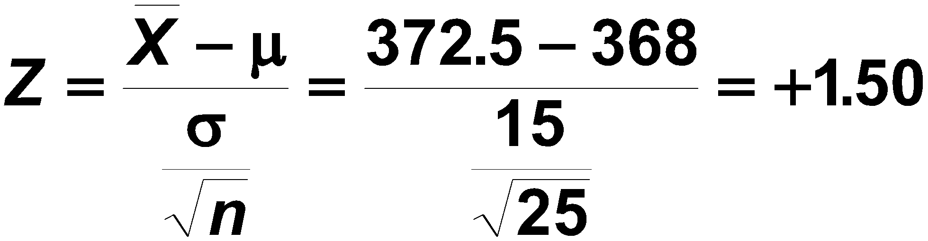
Two-Tailed Z Test Solution
H0: μ = 368
Ha: μ ≠ 368
α = .05
n = 25
Critical Value(s):
Test Statistic:
Decision:
Conclusion:

Slide 80
Two-Tailed Z Test Solution
H0: μ = 368
Ha: μ ≠ 368
α = .05
n = 25
Critical Value(s):
Test Statistic:
Decision:
Conclusion:
Do not reject at α = .05

Slide 81
Two-Tailed Z Test Solution
H0: μ = 368
Ha: μ ≠ 368
α = .05
n = 25
Critical Value(s):
Test Statistic:
Decision:
Conclusion:
Do not reject at α = .05
No evidence average is not 368

Slide 82
Two-Tailed Z Test Thinking Challenge
You’re a Q/C inspector. You want to find out if a new machine is making electrical cords to customer specification: average breaking strength of 70 lb. with σ = 3.5 lb. You take a sample of 36 cords & compute a sample mean of 69.7 lb. At the .05 level, is there evidence that the machine is not meeting the average breaking strength?

Slide 83
Two-Tailed Z Test Solution*
H0:
Ha:
α =
n =
Critical Value(s):
Test Statistic:
Decision:
Conclusion:

Slide 84
Two-Tailed Z Test Solution*
H0: μ = 70
Ha: μ ≠ 70
α =
n =
Critical Value(s):
Test Statistic:
Decision:
Conclusion:

Slide 85
Two-Tailed Z Test Solution*
H0: μ = 70
Ha: μ ≠ 70
α = .05
n = 36
Critical Value(s):
Test Statistic:
Decision:
Conclusion:

Slide 86
Two-Tailed Z Test Solution*
H0: μ = 70
Ha: μ ≠ 70
α = .05
n = 36
Critical Value(s):
Test Statistic:
Decision:
Conclusion:

Slide 87
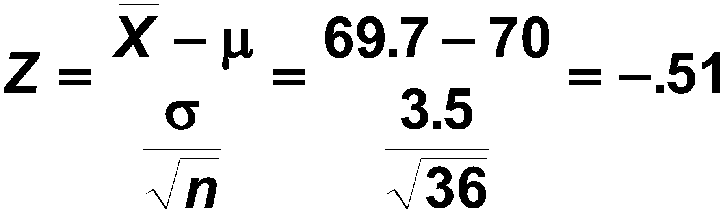
Two-Tailed Z Test Solution*
H0: μ = 70
Ha: μ ≠ 70
α = .05
n = 36
Critical Value(s):
Test Statistic:
Decision:
Conclusion:

Slide 88
Two-Tailed Z Test Solution*
H0: μ = 70
Ha: μ ≠ 70
α = .05
n = 36
Critical Value(s):
Test Statistic:
Decision:
Conclusion:
Do not reject at α = .05

Slide 89
Two-Tailed Z Test Solution*
H0: μ = 70
Ha: μ ≠ 70
α = .05
n = 36
Critical Value(s):
Test Statistic:
Decision:
Conclusion:
Do not reject at α = .05
No evidence average is not 70

Slide 90
One-Tailed Z Test of Mean (σ Known)
Notes:
9

Slide 91
One-Tailed Z Test for Mean (σ Known)
1. Assumptions
Population Is Normally Distributed
If Not Normal, Can Be Approximated by Normal Distribution (n ≥ 30)
2. Alternative Hypothesis Has < or > Sign

Slide 92
One-Tailed Z Test for Mean (σ Known)
1. Assumptions
Population Is Normally Distributed
If Not Normal, Can Be Approximated by Normal Distribution (n ≥ 30)
2. Alternative Hypothesis Has < or > Sign
3. Z-test Statistic

Slide 93
One-Tailed Z Test for Mean Hypotheses

Slide 94
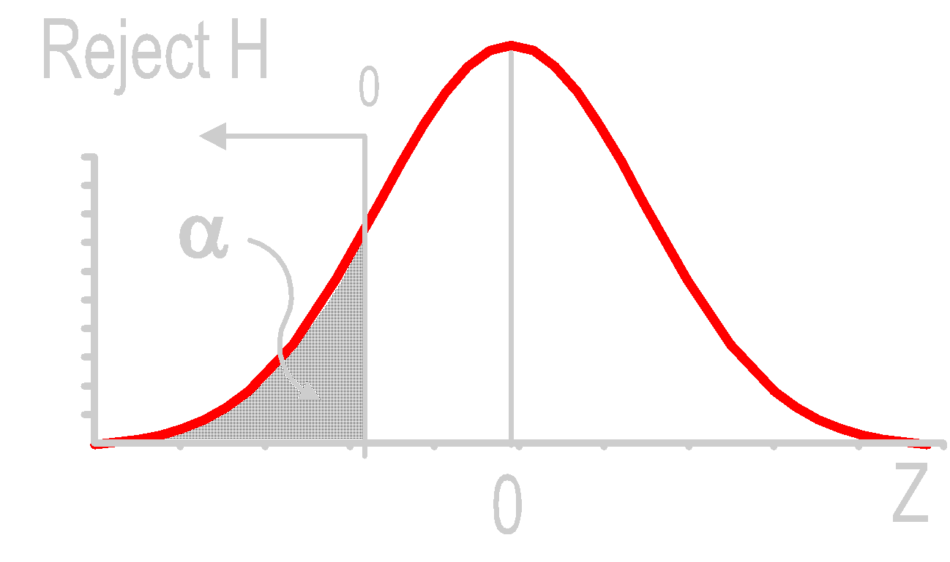
One-Tailed Z Test for Mean Hypotheses
H₀: μ = 0 H_{a}: μ < 0
Must be significantly below μ

Slide 95
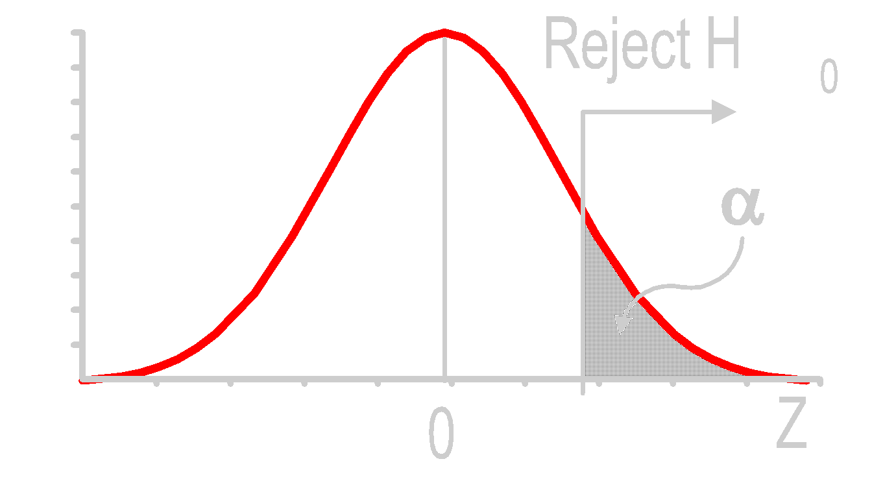
One-Tailed Z Test for Mean Hypotheses
H₀: μ = 0 H_{a}: μ < 0
H₀: μ = 0 H_{a}: μ > 0
Must be significantly below μ
Small values satisfy H₀ . Don’t reject!

Slide 96
One-Tailed Z Test Finding Critical Z

Slide 97
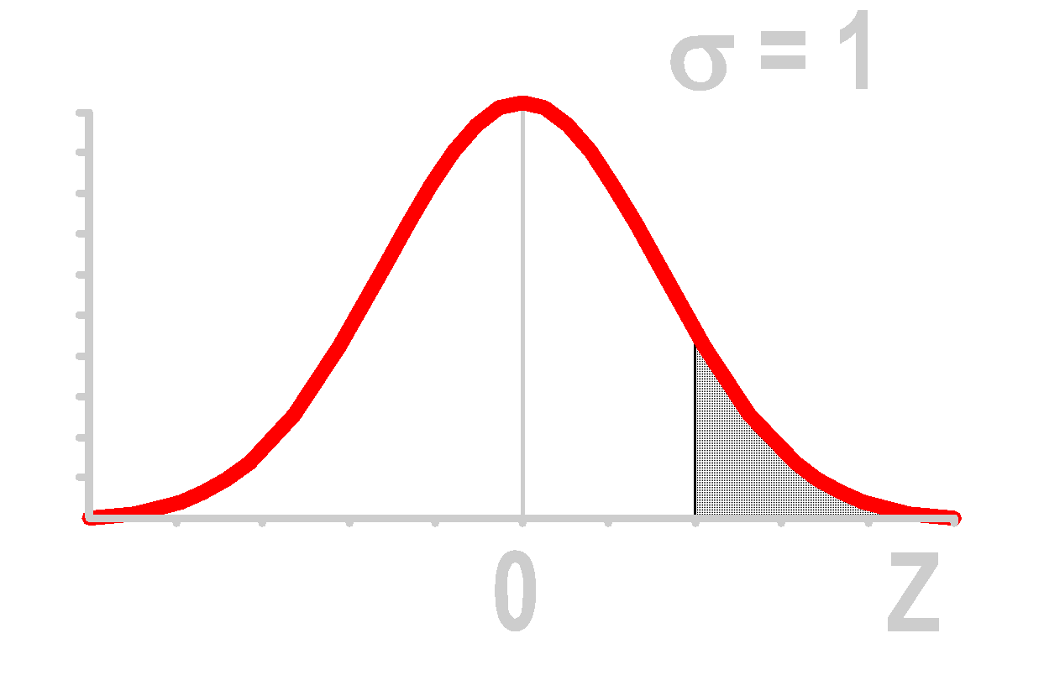
One-Tailed Z Test Finding Critical Z
What Is Z given α = .025?
α = .025
①

Slide 98
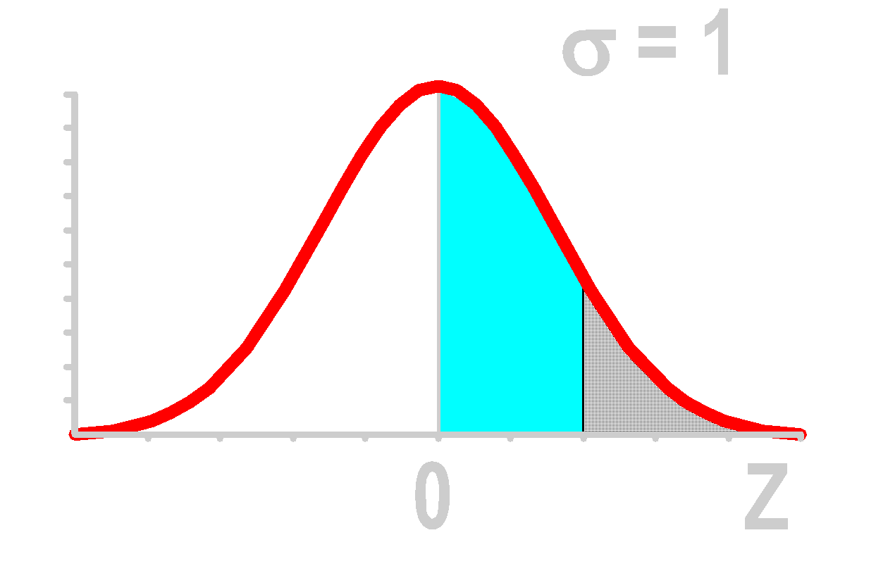
One-Tailed Z Test Finding Critical Z
What Is Z given α = .025?
②
.500 - .025 .475
α = .025
①

Slide 99
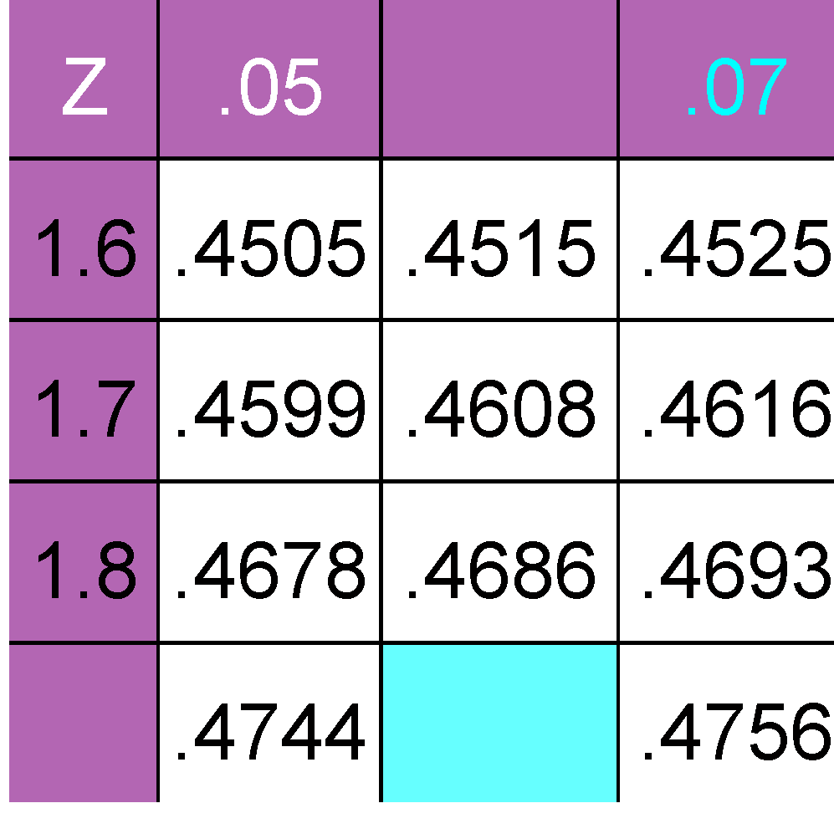
One-Tailed Z Test Finding Critical Z
What Is Z given α = .025?
Standardized Normal Probability Table (Portion)
②
③
.500 - .025 .475
.06
α = .025
①
1.9
.4750

Slide 100
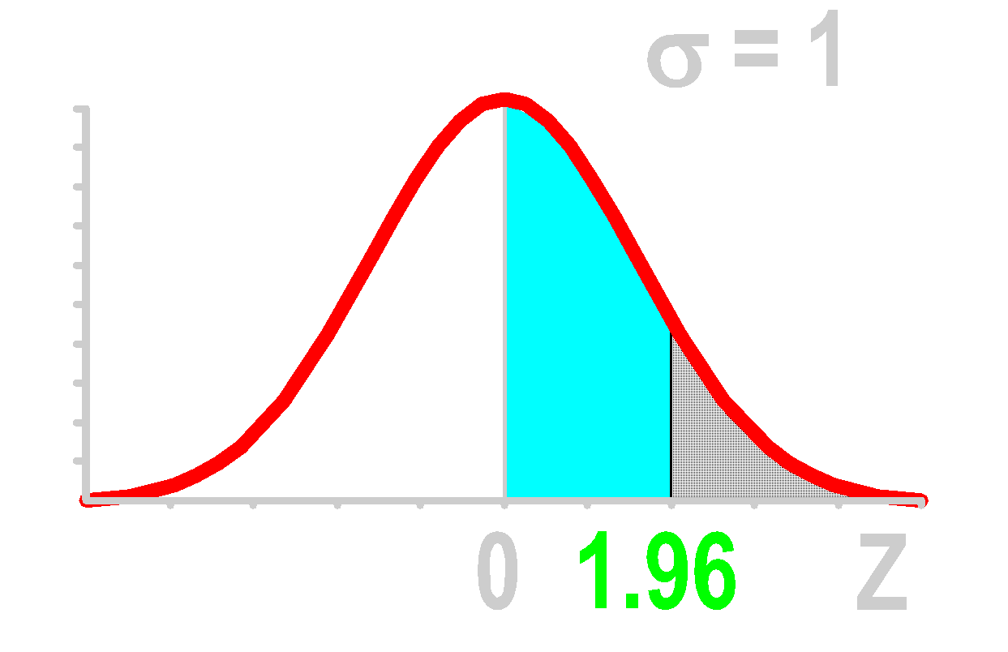
One-Tailed Z Test Finding Critical Z
What Is Z given α = .025?
Standardized Normal Probability Table (Portion)
②
③
.500 - .025 .475
.06
α = .025
①
④
1.9
.4750

Slide 101
One-Tailed Z Test Example
Does an average box of cereal contain more than 368 grams of cereal? A random sample of 25 boxes showedX = 372.5. The company has specified σ to be 25 grams. Test at the .05 level.
368 gm.

Slide 102
One-Tailed Z Test Solution
H0:
Ha:
α =
n =
Critical Value(s):
Test Statistic:
Decision:
Conclusion:

Slide 103
One-Tailed Z Test Solution
H0: μ = 368
Ha: μ > 368
α =
n =
Critical Value(s):
Test Statistic:
Decision:
Conclusion:

Slide 104
One-Tailed Z Test Solution
H0: μ = 368
Ha: μ > 368
α = .05
n = 25
Critical Value(s):
Test Statistic:
Decision:
Conclusion:

Slide 105
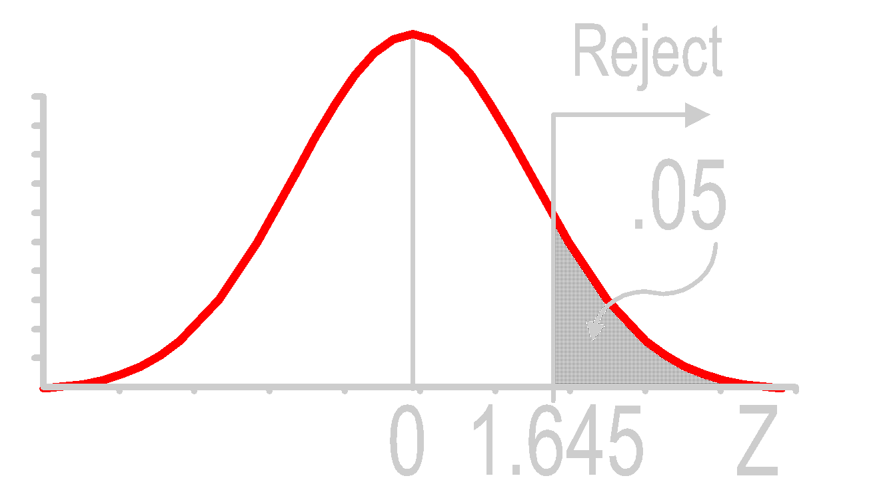
One-Tailed Z Test Solution
H0: μ = 368
Ha: μ > 368
α = .05
n = 25
Critical Value(s):
Test Statistic:
Decision:
Conclusion:

Slide 106
One-Tailed Z Test Solution
H0: μ = 368
Ha: μ > 368
α = .05
n = 25
Critical Value(s):
Test Statistic:
Decision:
Conclusion:

Slide 107
One-Tailed Z Test Solution
H0: μ = 368
Ha: μ > 368
α = .05
n = 25
Critical Value(s):
Test Statistic:
Decision:
Conclusion:
Do not reject at α = .05

Slide 108
One-Tailed Z Test Solution
H0: μ = 368
Ha: μ > 368
α = .05
n = 25
Critical Value(s):
Test Statistic:
Decision:
Conclusion:
Do not reject at α = .05
No evidence average is more than 368

Slide 109
One-Tailed Z Test Thinking Challenge
You’re an analyst for Ford. You want to find out if the average miles per gallon of Escorts is at least 32 mpg. Similar models have a standard deviation of 3.8 mpg. You take a sample of 60 Escorts & compute a sample mean of 30.7 mpg. At the .01 level, is there evidence that the miles per gallon is at least 32?

Slide 110
One-Tailed Z Test Solution*
H0:
Ha:
α =
n =
Critical Value(s):
Test Statistic:
Decision:
Conclusion:

Slide 111
One-Tailed Z Test Solution*
H0: μ = 32
Ha: μ < 32
α =
n =
Critical Value(s):
Test Statistic:
Decision:
Conclusion:

Slide 112
One-Tailed Z Test Solution*
H0: μ = 32
Ha: μ < 32
α = .01
n = 60
Critical Value(s):
Test Statistic:
Decision:
Conclusion:

Slide 113
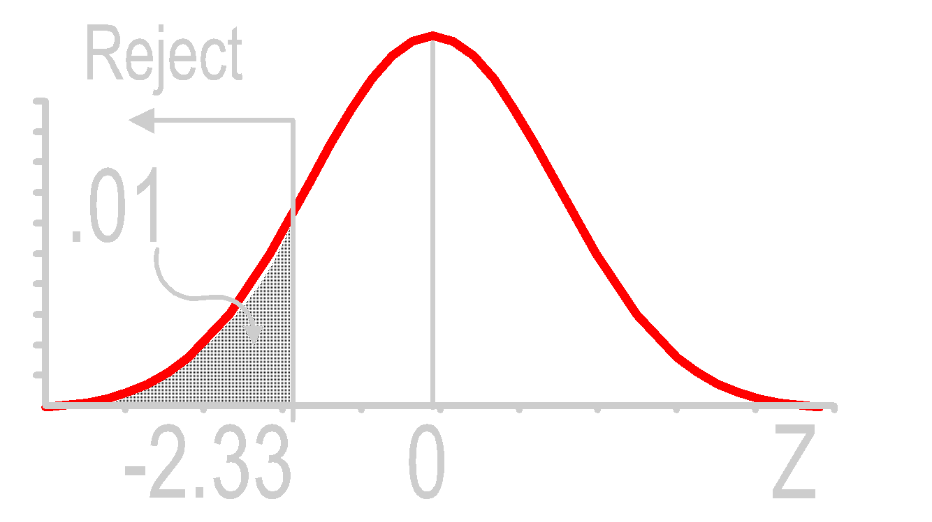
One-Tailed Z Test Solution*
H0: μ = 32
Ha: μ < 32
α = .01
n = 60
Critical Value(s):
Test Statistic:
Decision:
Conclusion:

Slide 114
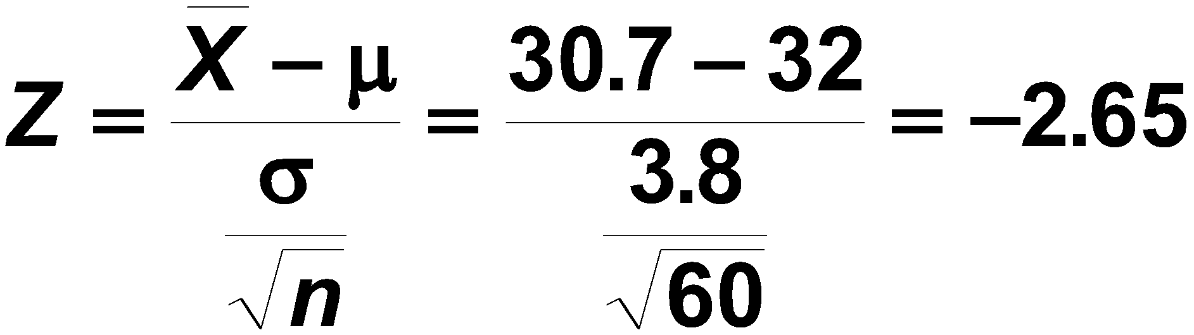
One-Tailed Z Test Solution*
H0: μ = 32
Ha: μ < 32
α = .01
n = 60
Critical Value(s):
Test Statistic:
Decision:
Conclusion:

Slide 115
One-Tailed Z Test Solution*
H0: μ = 32
Ha: μ < 32
α = .01
n = 60
Critical Value(s):
Test Statistic:
Decision:
Conclusion:
Reject at α = .01

Slide 116

One-Tailed Z Test Thinking Challenge
A principal at a certain school claims that the students in his school are above average intelligence. A random sample of thirty students IQ scores have a mean score of 112. Is there sufficient evidence to support the principal’s claim? The mean population IQ is 100 with a standard deviation of 15.

Slide 117
One-Tailed Z Test Solution*
H0:
Ha:
α =
n =
Critical Value(s):
Test Statistic:
Decision:
Conclusion:

Slide 118
One-Tailed Z Test Solution*
H0: μ = 100
Ha: μ > 100
α =
n =
Critical Value(s):
Test Statistic:
Decision:
Conclusion:

Slide 119
One-Tailed Z Test Solution*
H0: μ = 100
Ha: μ > 100
α = .05
n = 30
Critical Value(s):
Test Statistic:
Decision:
Conclusion:

Slide 120
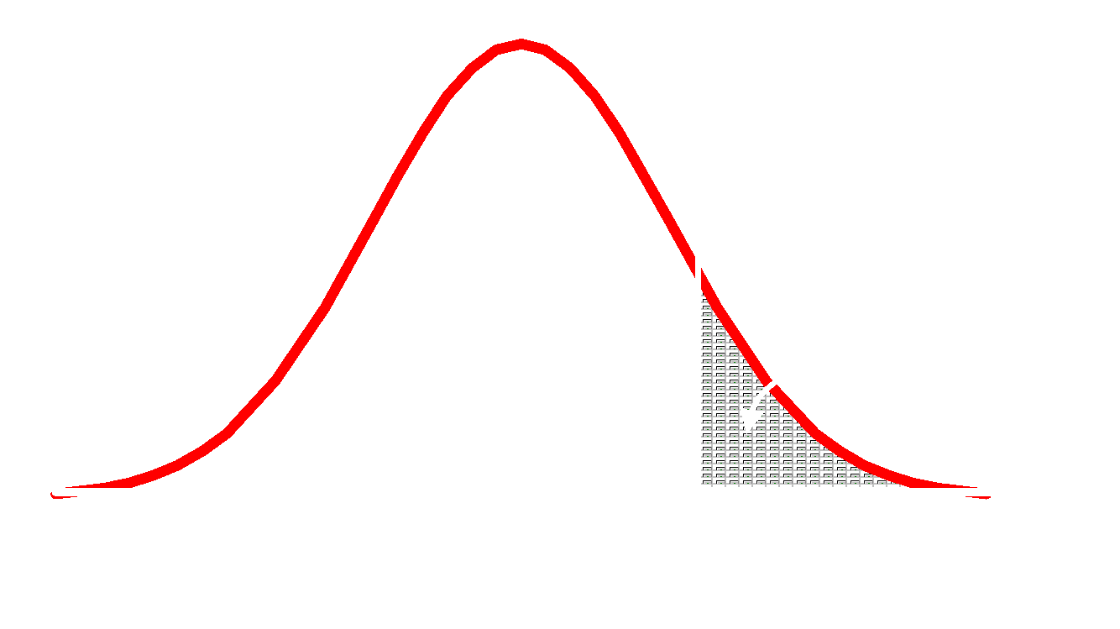
One-Tailed Z Test Solution*
H0: μ = 100
Ha: μ > 100
α = .05
n = 30
Critical Value(s):
Test Statistic:
Decision:
Conclusion:

Slide 121
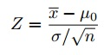
One-Tailed Z Test Solution*
H0: μ = 100
Ha: μ > 100
α = .05
n = 30
Critical Value(s):
Test Statistic:
Decision:
Conclusion:
z= (112.– 100) / (15/√30) = 4.56

Slide 122
One-Tailed Z Test Solution*
H0: μ = 100
Ha: μ > 100
α = .05
n = 30
Critical Value(s):
Test Statistic:
Decision:
Conclusion:
z= (112.– 100) / (15/√30) = 4.56
Reject at α = .05

Slide 123
One-Tailed Z Test Solution*
H0: μ = 100
Ha: μ > 100
α = .05
n = 30
Critical Value(s):
Test Statistic:
Decision:
Conclusion:
z= (112.– 100) / (15/√30) = 4.56
Reject at α = .05
There is evidence average is less than 100

Slide 124
Observed Significance Levels: p-Values
Notes:
9

Slide 125
p-Value
1. Probability of Obtaining a Test Statistic More Extreme (≤ or ≥) than Actual Sample Value Given H₀ Is True
2. Called Observed Level of Significance
Smallest Value of α H₀ Can Be Rejected
3. Used to Make Rejection Decision
If p-Value ≥ α, Do Not Reject H₀
If p-Value < α, Reject H₀

Slide 126
p-Value
Null Hypothesis: H₀: µ = 3
Assumption: Null Hypothesis is True
p-Value: P(X > 3.2 | Ho: μ = 3)
Notes:
P-value: The probability of observing data at least as extreme as the one observed in the original study, under the assumption that the null hypothesis is true, is called the p-value. It is the numerical criteria used for making decisions between competing hypotheses.

Slide 127
p-Value
A sample of 50 college students were asked, how many course projects they have done on their own so far. The students in the sample had an average of 3.2 projects with a SD of 1.74. Estimate the true average number of projects based on this sample, using a 95% Confidence Interval.
Notes:
P-value: The probability of observing data at least as extreme as the one observed in the original study, under the assumption that the null hypothesis is true, is called the p-value. It is the numerical criteria used for making decisions between competing hypotheses.

Slide 128
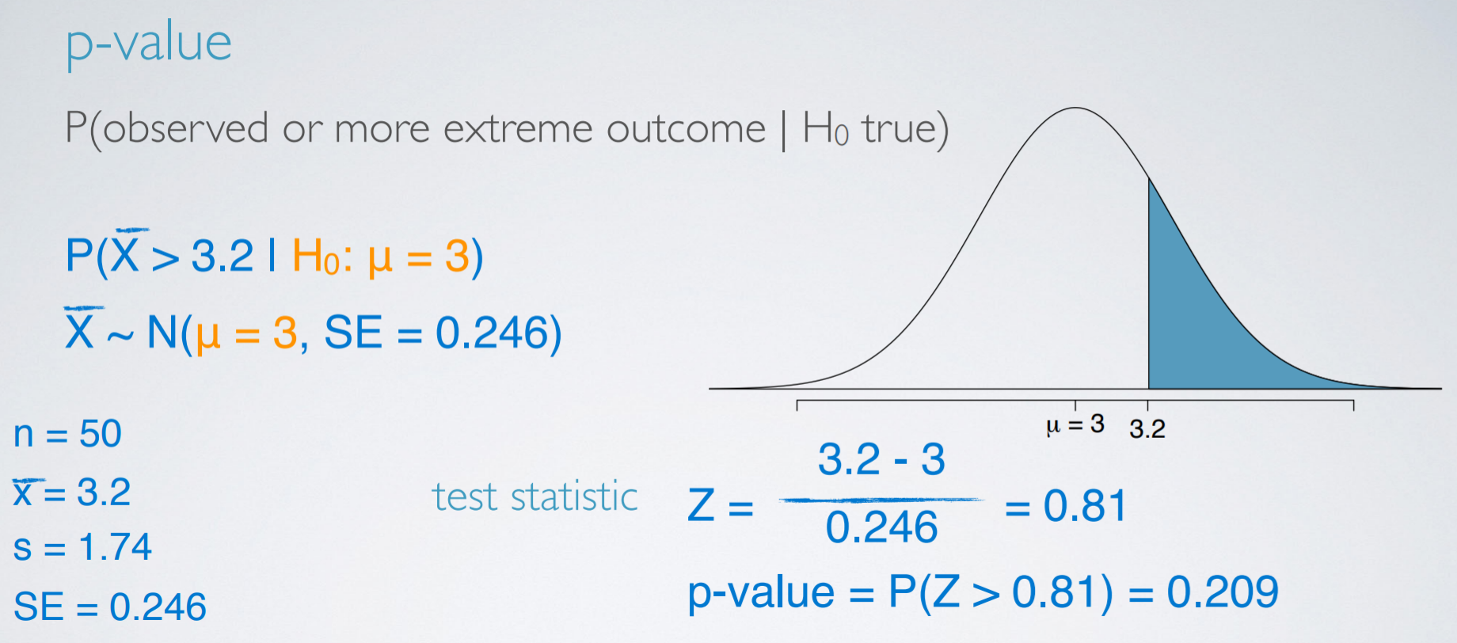
p-Value
50 college students, Sample average: 3.2, Sample SD: 1.74,
95% Confidence Interval.
Notes:
We used the test –statistic to calculate the p-value, which is the probability of observing data at least as favorable to the alternative hypothesis as our current data set, if the null hypothesis was true.
If the p-value is low – lower than a defined significance level α, which is usually 5%, we say that it would be very unlikely to observe the data, if the null hypothesis were true and hence reject null hypothesis.
If the p-value is high – (Higher than significance level α), we say that it is likely to observe the data even if the null hypothesis were true, and hence do not reject the null hypothesis.
Since p-value is 0.209, we do not reject the null hypothesis

Slide 129
Two-Tailed Z Test p-Value Example
Does an average box of cereal contain 368 grams of cereal? A random sample of 25 boxes showedX = 372.5. The company has specified σ to be 25 grams. Find the p-Value.
368 gm.

Slide 130
Two-Tailed Z Test p-Value Solution

Slide 131
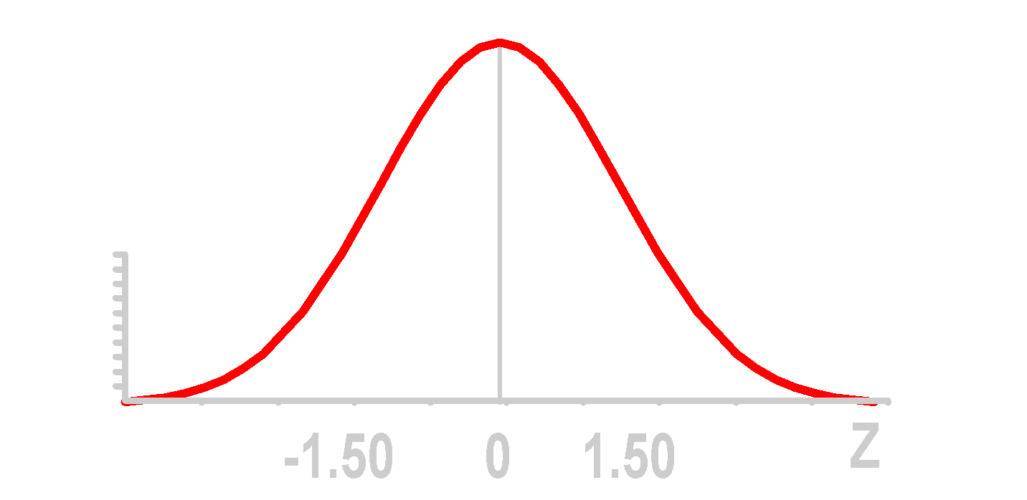
Two-Tailed Z Test p-Value Solution
①
Z value of sample statistic (observed)

Slide 132
Two-Tailed Z Test p-Value Solution
p-value is P(Z ≤ -1.50 or Z ≥ 1.50)
①
Z value of sample statistic (observed)

Slide 133
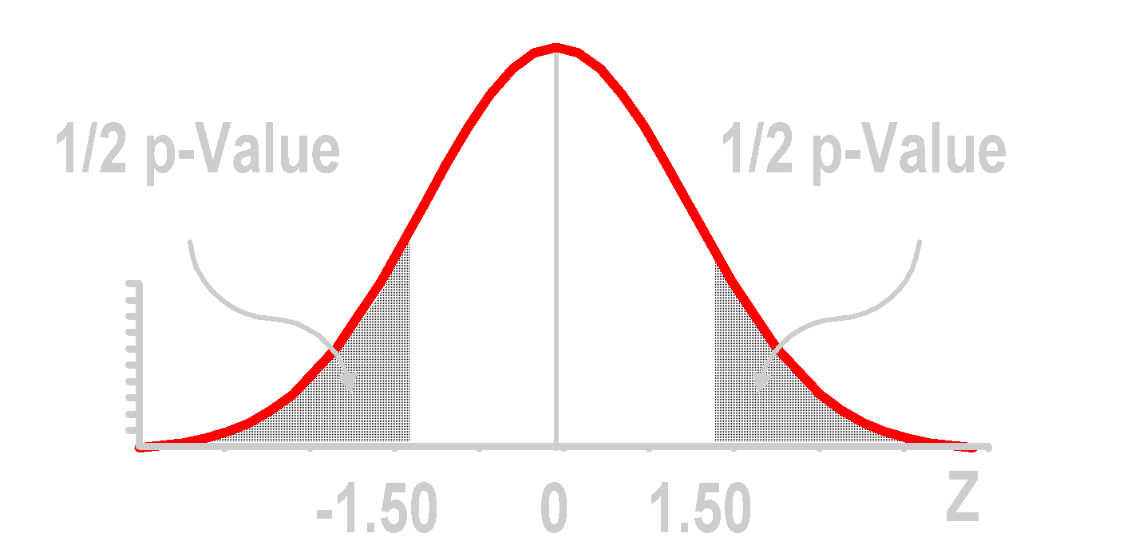
Two-Tailed Z Test p-Value Solution
p-value is P(Z ≤ -1.50 or Z ≥ 1.50)
①
Z value of sample statistic (observed)

Slide 134
Two-Tailed Z Test p-Value Solution
p-value is P(Z ≤ -1.50 or Z ≥ 1.50)
.4332
②
From Z table: lookup 1.50
①
Z value of sample statistic (observed)

Slide 135
Two-Tailed Z Test p-Value Solution
p-value is P(Z ≤ -1.50 or Z ≥ 1.50)
③
.5000 - .4332 .0668
.4332
②
From Z table: lookup 1.50
①
Z value of sample statistic (observed)

Slide 136
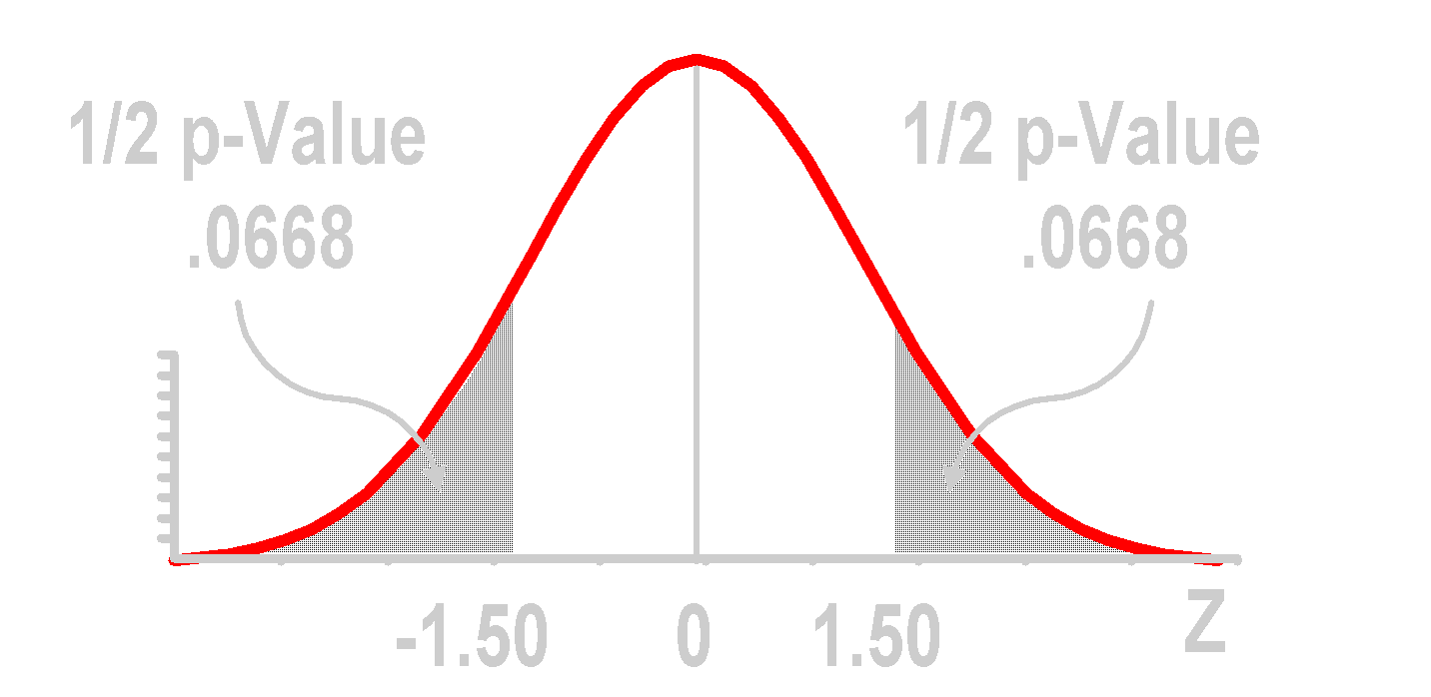
Two-Tailed Z Test p-Value Solution
p-value is P(Z ≤ -1.50 or Z ≥ 1.50) = .1336
③
.5000 - .4332 .0668
.4332
②
From Z table: lookup 1.50
①
Z value of sample statistic

Slide 137
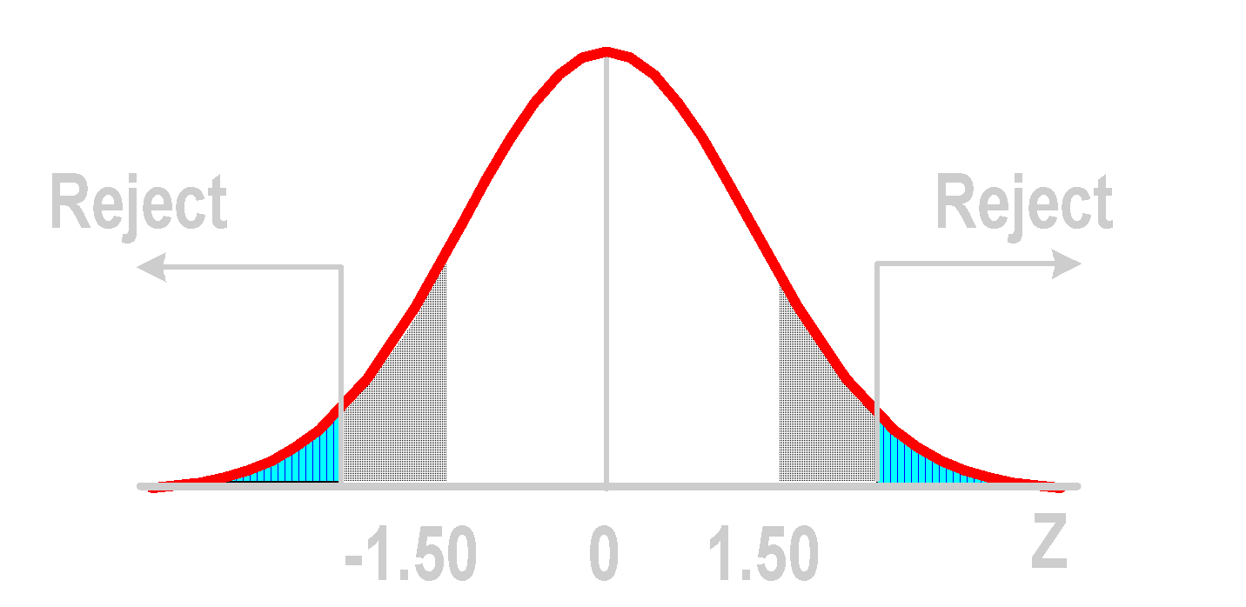
Two-Tailed Z Test p-Value Solution
1/2 p-Value = .0668
1/2 p-Value = .0668
1/2 α = .025
1/2 α = .025

Slide 138
Two-Tailed Z Test p-Value Solution
(p-Value = .1336) ≥ (α = .05). Do not reject.
1/2 p-Value = .0668
1/2 p-Value = .0668
1/2 α = .025
1/2 α = .025
Test statistic is in ‘Do not reject’ region

Slide 139
One-Tailed Z Test p-Value Example
Does an average box of cereal contain more than 368 grams of cereal? A random sample of 25 boxes showedX = 372.5. The company has specified σ to be 25 grams. Find the p-Value.
368 gm.

Slide 140
One-Tailed Z Test p-Value Solution

Slide 141
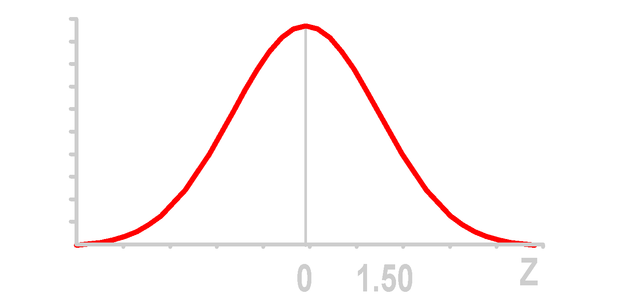
One-Tailed Z Test p-Value Solution
①
Z value of sample statistic

Slide 142
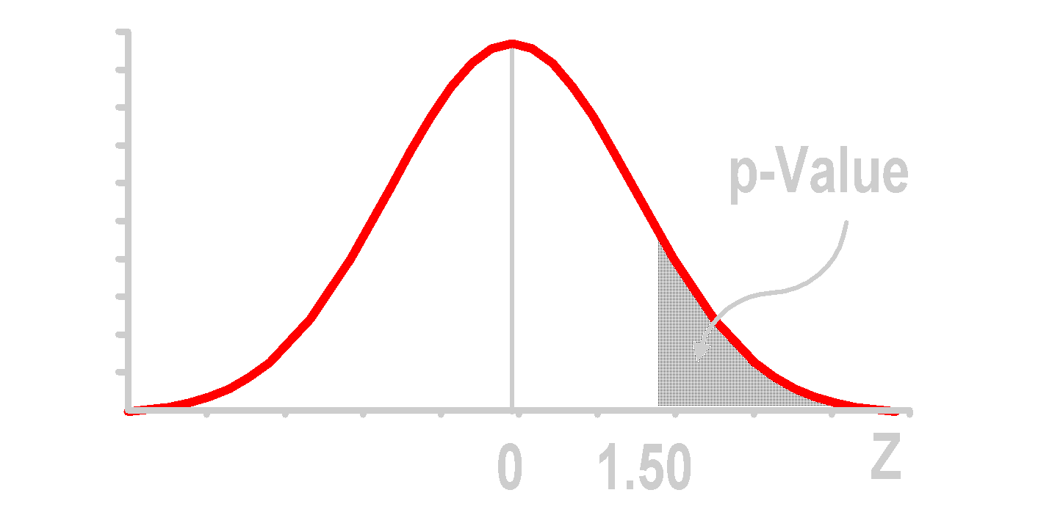
One-Tailed Z Test p-Value Solution
p-Value is P(Z ≥ 1.50)
②
Use alternative hypothesis to find direction
①
Z value of sample statistic

Slide 143
One-Tailed Z Test p-Value Solution
p-Value is P(Z ≥ 1.50)
②
Use alternative hypothesis to find direction
.4332
③
From Z table: lookup 1.50
①
Z value of sample statistic

Slide 144
One-Tailed Z Test p-Value Solution
p-Value is P(Z ≥ 1.50)
②
④
Use alternative hypothesis to find direction
.5000 - .4332 .0668
.4332
③
From Z table: lookup 1.50
①
Z value of sample statistic

Slide 145
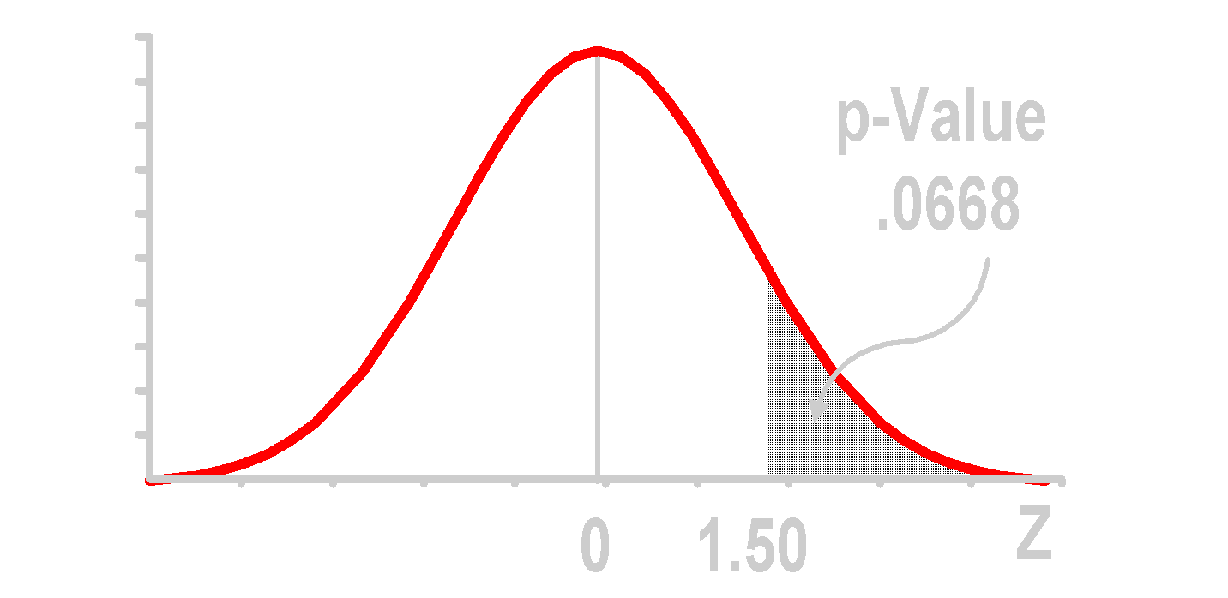
One-Tailed Z Test p-Value Solution
p-Value is P(Z ≥ 1.50) = .0668
②
④
Use alternative hypothesis to find direction
.5000 - .4332 .0668
.4332
③
From Z table: lookup 1.50
①
Z value of sample statistic

Slide 146
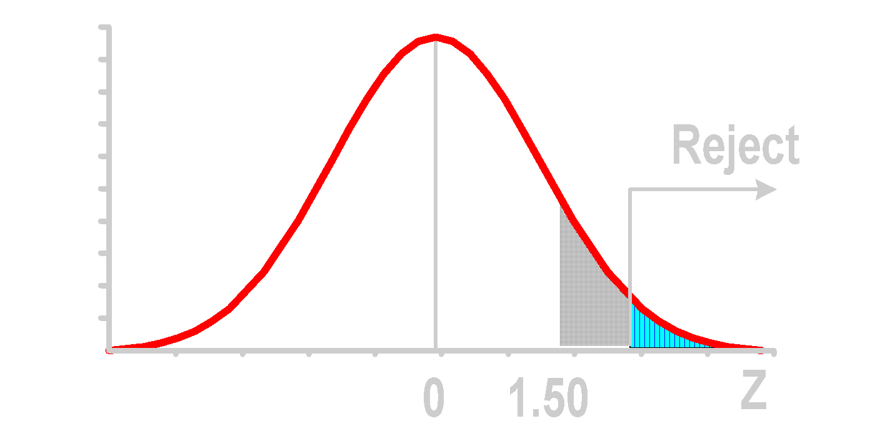
One-Tailed Z Test p-Value Solution
p-Value = .0668
α = .05

Slide 147
One-Tailed Z Test p-Value Solution
(p-Value = .0668) ≥ (α = .05). Do not reject.
p-Value = .0668
α = .05
Test statistic is in ‘Do not reject’ region

Slide 148
p-Value Thinking Challenge
You’re an analyst for Ford. You want to find out if the average miles per gallon of Escorts is at least 32 mpg. Similar models have a standard deviation of 3.8 mpg. You take a sample of 60 Escorts & compute a sample mean of 30.7 mpg. What is the value of the observed level of significance (p-Value)?
Notes:
.

Slide 149
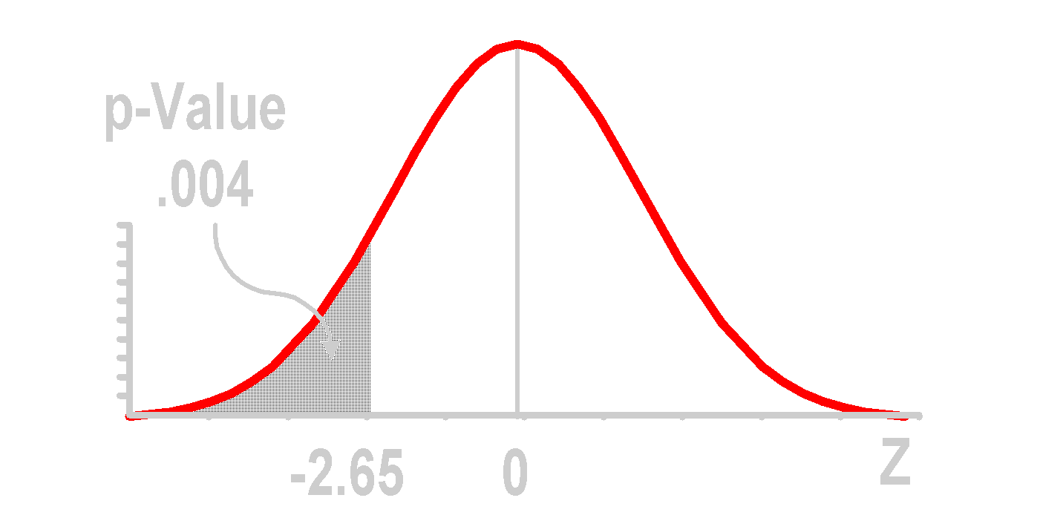
p-Value Solution*
p-Value is P(Z ≤ -2.65) = .004. p-Value < (α = .01). Reject H₀.
①
④
Use alternative hypothesis to find direction
.5000 - .4960 .0040
.4960
②
Z value of sample statistic
③
From Z table: lookup 2.65

Slide 150
Two-Tailed t Test of Mean (σ Unknown)
Notes:
9

Slide 151
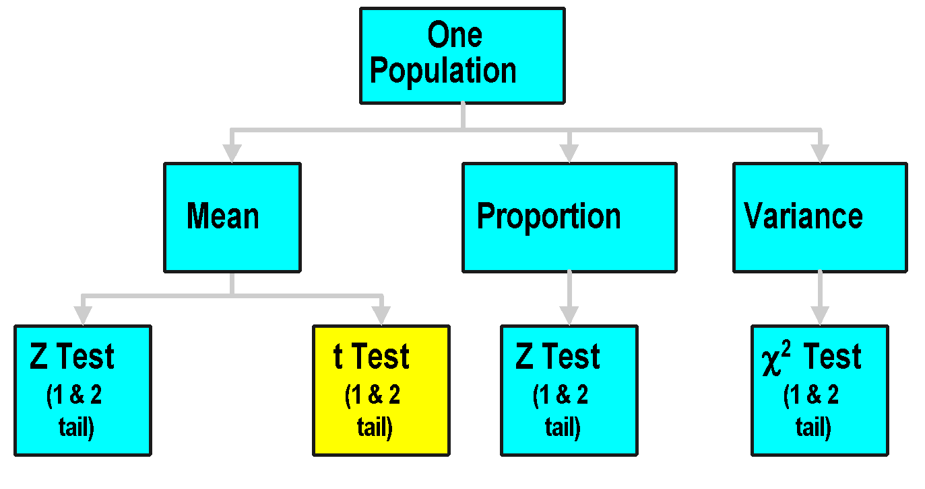
One Population Tests

Slide 152
t Test for Mean (σ Unknown)
1. Assumptions
Population Is Normally Distributed
If Not Normal, Only Slightly Skewed & Large Sample (n ≥ 30) Taken
2. Parametric Test Procedure

Slide 153
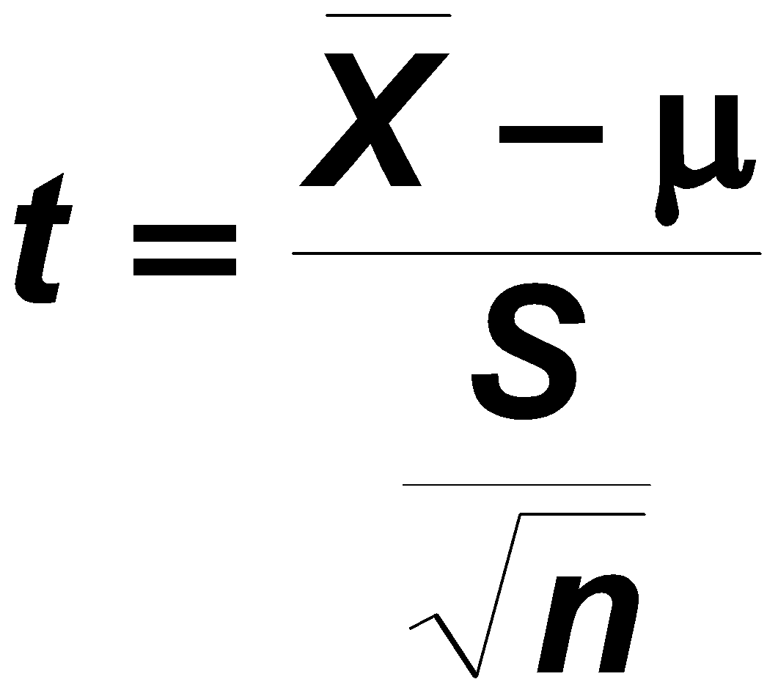
t Test for Mean (σ Unknown)
1. Assumptions
Population Is Normally Distributed
If Not Normal, Only Slightly Skewed & Large Sample (n ≥ 30) Taken
2. Parametric Test Procedure
3. t Test Statistic

Slide 154
Two-Tailed t Test Finding Critical t Values

Slide 155
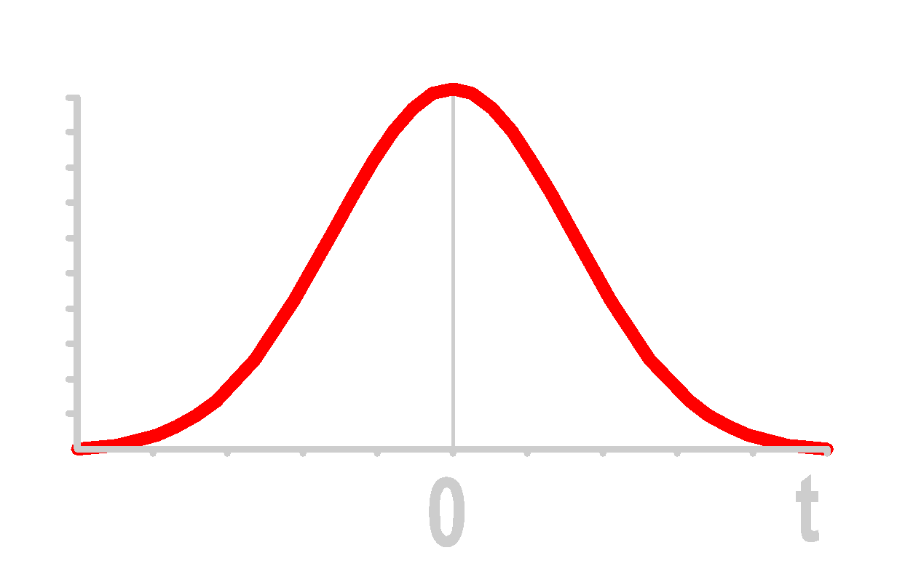
Two-Tailed t Test Finding Critical t Values
Given: n = 3; α = .10

Slide 156
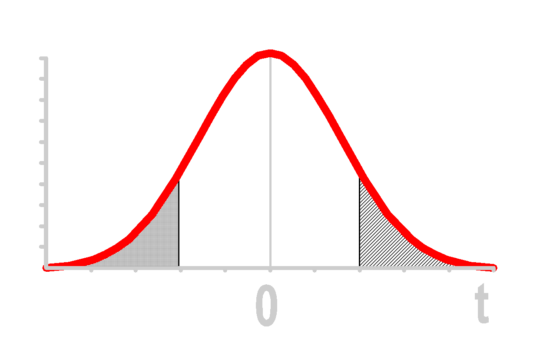
Two-Tailed t Test Finding Critical t Values
Given: n = 3; α = .10
①
α /2 = .05
α /2 = .05

Slide 157
Two-Tailed t Test Finding Critical t Values
Given: n = 3; α = .10
df = n - 1 = 2
②
①
α /2 = .05
α /2 = .05

Slide 158
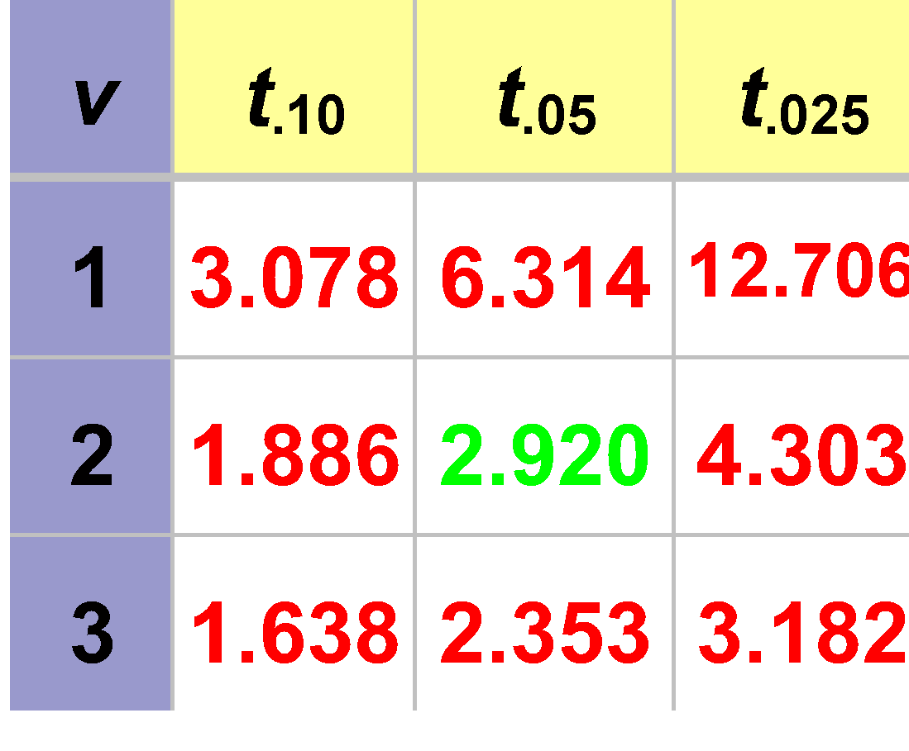
Two-Tailed t Test Finding Critical t Values
Given: n = 3; α = .10
Critical Values of t Table (Portion)
③
df = n - 1 = 2
②
①
α /2 = .05
α /2 = .05

Slide 159
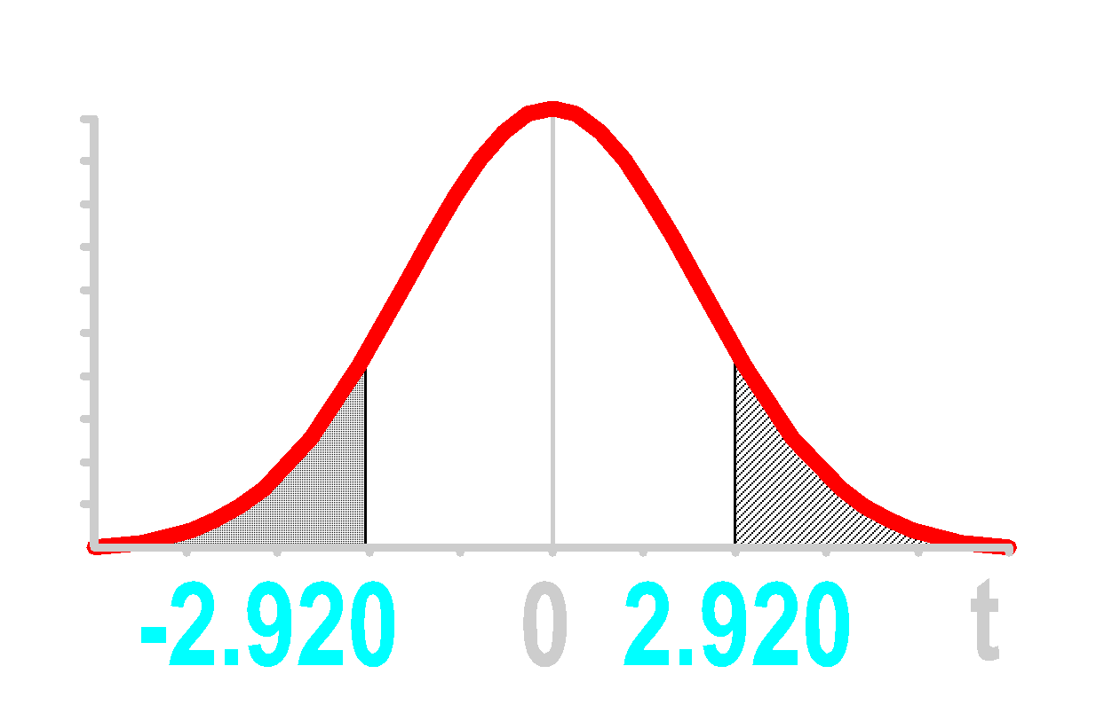
Two-Tailed t Test Finding Critical t Values
Given: n = 3; α = .10
Critical Values of t Table (Portion)
③
df = n - 1 = 2
②
①
α /2 = .05
α /2 = .05
④

Slide 160
Two-Tailed t Test Example
Does an average box of cereal contain 368 grams of cereal? A random sample of 36 boxes had a mean of 372.5 & a standard deviation of 12 grams. Test at the .05 level.
368 gm.

Slide 161
Two-Tailed t Test Solution
H0:
Ha:
α =
df =
Critical Value(s):
Test Statistic:
Decision:
Conclusion:

Slide 162
Two-Tailed t Test Solution
H0: μ = 368
Ha: μ ≠ 368
α =
df =
Critical Value(s):
Test Statistic:
Decision:
Conclusion:

Slide 163
Two-Tailed t Test Solution
H0: μ = 368
Ha: μ ≠ 368
α = .05
df = 36 - 1 = 35
Critical Value(s):
Test Statistic:
Decision:
Conclusion:

Slide 164
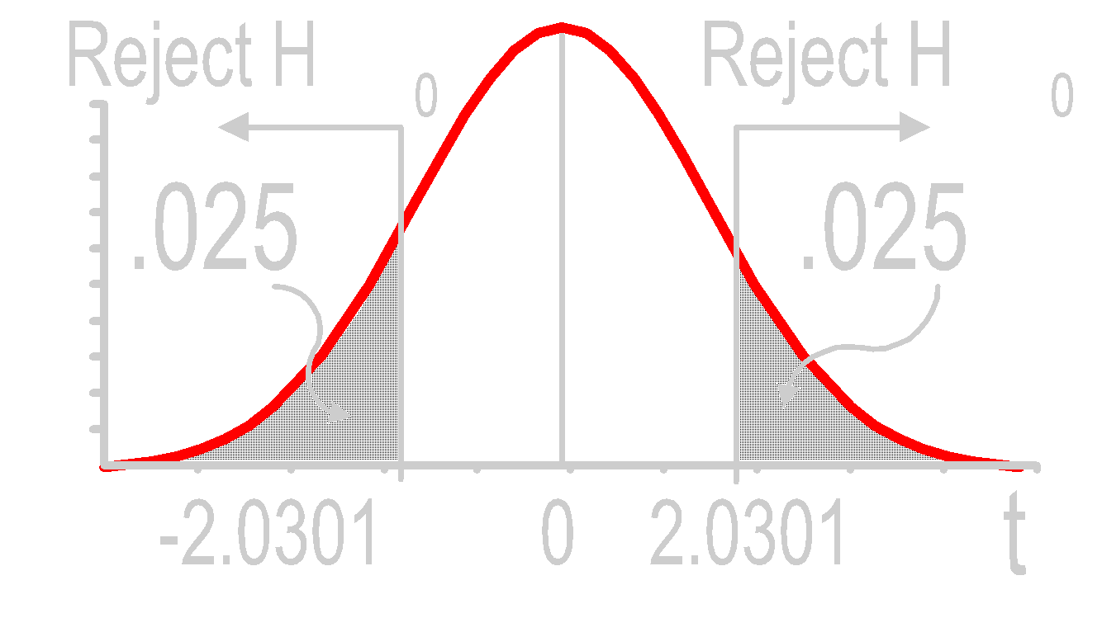
Two-Tailed t Test Solution
H0: μ = 368
Ha: μ ≠ 368
α = .05
df = 36 - 1 = 35
Critical Value(s):
Test Statistic:
Decision:
Conclusion:

Slide 165
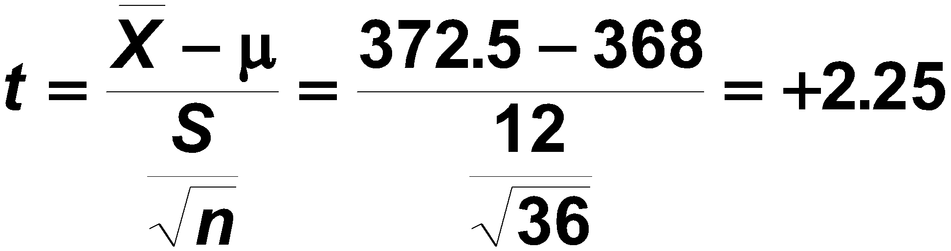
Two-Tailed t Test Solution
H0: μ = 368
Ha: μ ≠ 368
α = .05
df = 36 - 1 = 35
Critical Value(s):
Test Statistic:
Decision:
Conclusion:

Slide 166
Two-Tailed t Test Solution
H0: μ = 368
Ha: μ ≠ 368
α = .05
df = 36 - 1 = 35
Critical Value(s):
Test Statistic:
Decision:
Conclusion:
Reject at α = .05

Slide 167
Two-Tailed t Test Solution
H0: μ = 368
Ha: μ ≠ 368
α = .05
df = 36 - 1 = 35
Critical Value(s):
Test Statistic:
Decision:
Conclusion:
Reject at α = .05
There is evidence pop. average is not 368

Slide 168

Two-Tailed t Test Thinking Challenge
You work for the FTC. A manufacturer of detergent claims that the mean weight of detergent is 3.25 lb. You take a random sample of 64 containers. You calculate the sample average to be 3.238 lb. with a standard deviation of .117 lb. At the .01 level, is the manufacturer correct?
3.25 lb.
Notes:
Allow students about 10 minutes to finish this.

Slide 169
Two-Tailed t Test Solution*
H0:
Ha:
α =
df =
Critical Value(s):
Test Statistic:
Decision:
Conclusion:

Slide 170
Two-Tailed t Test Solution*
H0: μ = 3.25
Ha: μ ≠ 3.25
α =
df =
Critical Value(s):
Test Statistic:
Decision:
Conclusion:

Slide 171
Two-Tailed t Test Solution*
H0: μ = 3.25
Ha: μ ≠ 3.25
α = .01
df = 64 - 1 = 63
Critical Value(s):
Test Statistic:
Decision:
Conclusion:

Slide 172
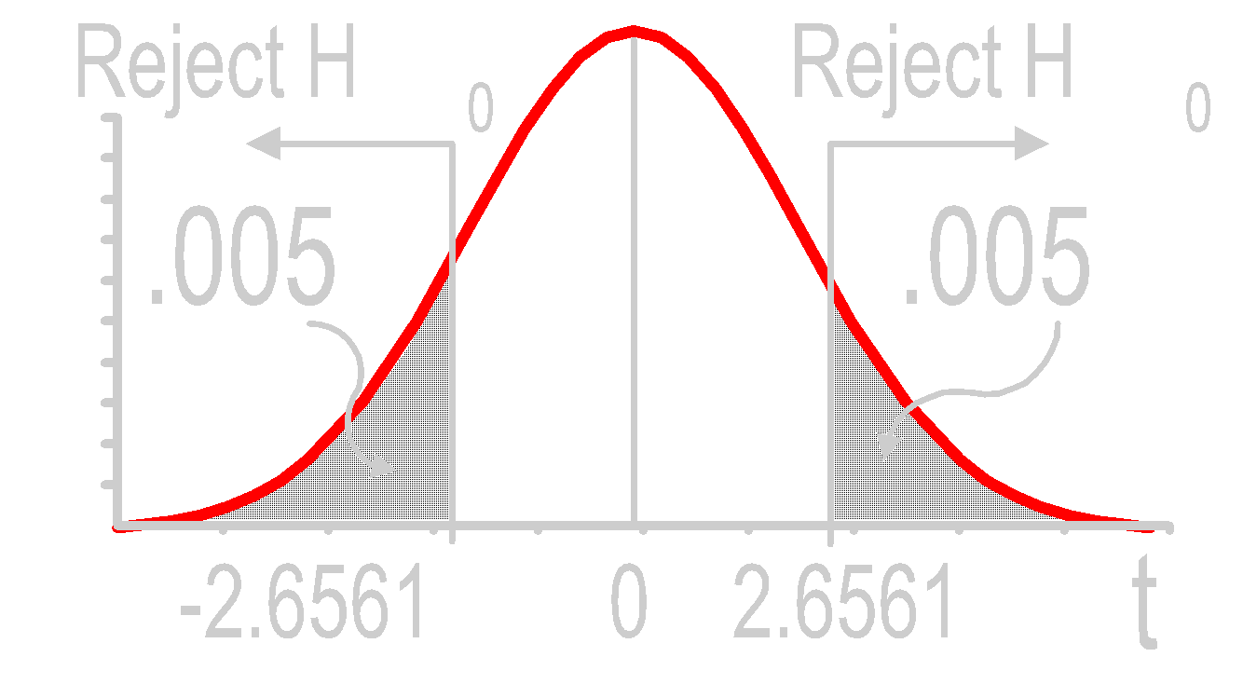
Two-Tailed t Test Solution*
H0: μ = 3.25
Ha: μ ≠ 3.25
α = .01
df = 64 - 1 = 63
Critical Value(s):
Test Statistic:
Decision:
Conclusion:

Slide 173
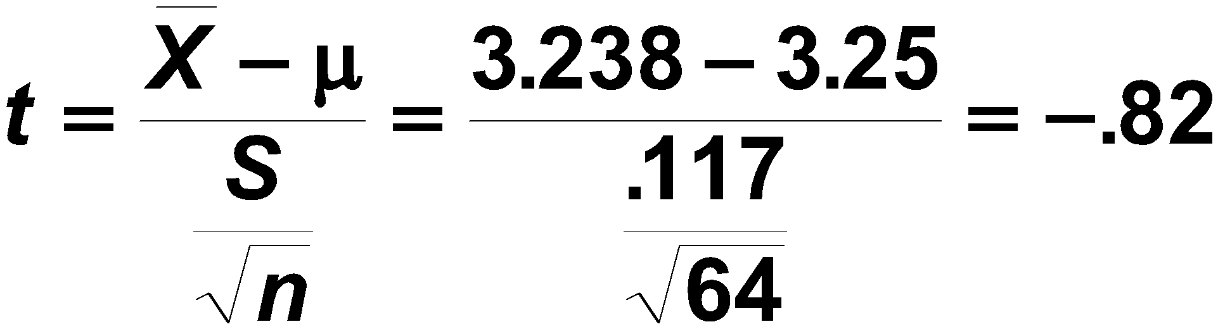
Two-Tailed t Test Solution*
H0: μ = 3.25
Ha: μ ≠ 3.25
α = .01
df = 64 - 1 = 63
Critical Value(s):
Test Statistic:
Decision:
Conclusion:

Slide 174
Two-Tailed t Test Solution*
H0: μ = 3.25
Ha: μ ≠ 3.25
α = .01
df = 64 - 1 = 63
Critical Value(s):
Test Statistic:
Decision:
Conclusion:
Do not reject at α = .01

Slide 175
Two-Tailed t Test Solution*
H0: μ = 3.25
Ha: μ ≠ 3.25
α = .01
df = 64 - 1 = 63
Critical Value(s):
Test Statistic:
Decision:
Conclusion:
Do not reject at α = .01
There is no evidence average is not 3.25

Slide 176
One-Tailed t Test of Mean (σ Unknown)
Notes:
9

Slide 177

One-Tailed t Test Example
Is the average capacity of batteries at least 140 ampere-hours? A random sample of 20 batteries had a mean of 138.47 & a standard deviation of 2.66. Assume a normal distribution. Test at the .05 level.

Slide 178
One-Tailed t Test Solution
H0:
Ha:
α =
df =
Critical Value(s):
Test Statistic:
Decision:
Conclusion:

Slide 179
One-Tailed t Test Solution
H0: μ = 140
Ha: μ < 140
α =
df =
Critical Value(s):
Test Statistic:
Decision:
Conclusion:

Slide 180
One-Tailed t Test Solution
H0: μ = 140
Ha: μ < 140
α = .05
df = 20 - 1 = 19
Critical Value(s):
Test Statistic:
Decision:
Conclusion:

Slide 181
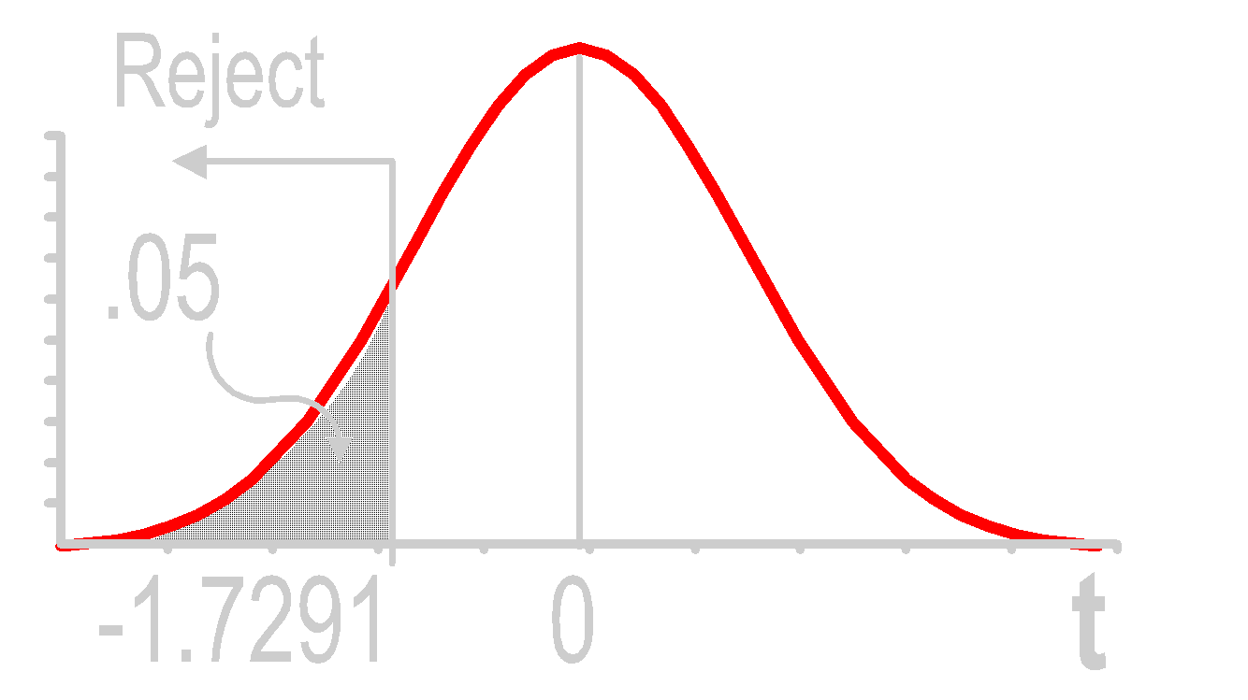
One-Tailed t Test Solution
H0: μ = 140
Ha: μ < 140
α = .05
df = 20 - 1 = 19
Critical Value(s):
Test Statistic:
Decision:
Conclusion:

Slide 182
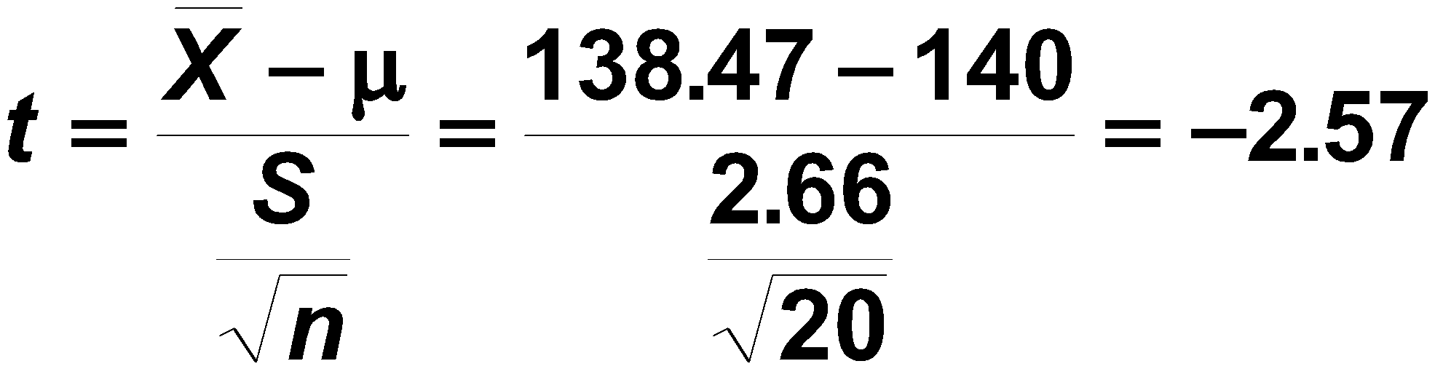
One-Tailed t Test Solution
H0: μ = 140
Ha: μ < 140
α = .05
df = 20 - 1 = 19
Critical Value(s):
Test Statistic:
Decision:
Conclusion:

Slide 183
One-Tailed t Test Solution
H0: μ = 140
Ha: μ < 140
α = .05
df = 20 - 1 = 19
Critical Value(s):
Test Statistic:
Decision:
Conclusion:
Reject at α = .05

Slide 184
One-Tailed t Test Solution
H0: μ = 140
Ha: μ < 140
α = .05
df = 20 - 1 = 19
Critical Value(s):
Test Statistic:
Decision:
Conclusion:
Reject at α = .05
There is evidence pop. average is less than 140

Slide 185

One-Tailed t Test Thinking Challenge
You’re a marketing analyst for Wal-Mart. Wal-Mart had teddy bears on sale last week. The weekly sales ($ 00) of bears sold in 10 stores was: 8 11 0 4 7 8 10 5 8 3. At the .05 level, is there evidence that the average bear sales per store is more than 5 ($ 00)?
Notes:
Assume that the population is normally distributed.
Allow students about 10 minutes to solve this.

Slide 186
One-Tailed t Test Solution*
H0:
Ha:
α =
df =
Critical Value(s):
Test Statistic:
Decision:
Conclusion:
Notes:
Note: More than 5 have been sold (6.4), but not enough to be significant.

Slide 187
One-Tailed t Test Solution*
H0: μ = 5
Ha: μ > 5
α =
df =
Critical Value(s):
Test Statistic:
Decision:
Conclusion:
Notes:
Note: More than 5 have been sold (6.4), but not enough to be significant.

Slide 188
One-Tailed t Test Solution*
H0: μ = 5
Ha: μ > 5
α = .05
df = 10 - 1 = 9
Critical Value(s):
Test Statistic:
Decision:
Conclusion:
Notes:
Note: More than 5 have been sold (6.4), but not enough to be significant.

Slide 189
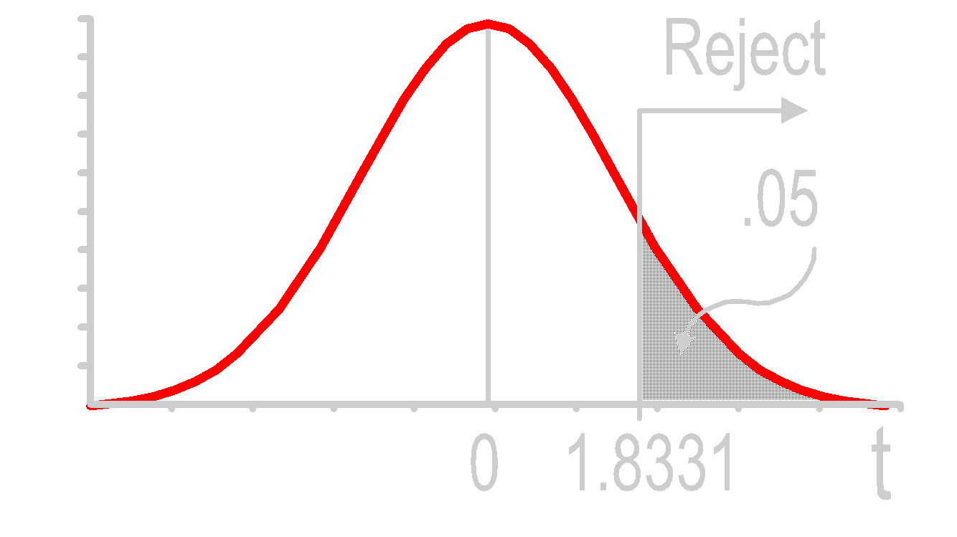
One-Tailed t Test Solution*
H0: μ = 5
Ha: μ > 5
α = .05
df = 10 - 1 = 9
Critical Value(s):
Test Statistic:
Decision:
Conclusion:
Notes:
Note: More than 5 have been sold (6.4), but not enough to be significant.

Slide 190
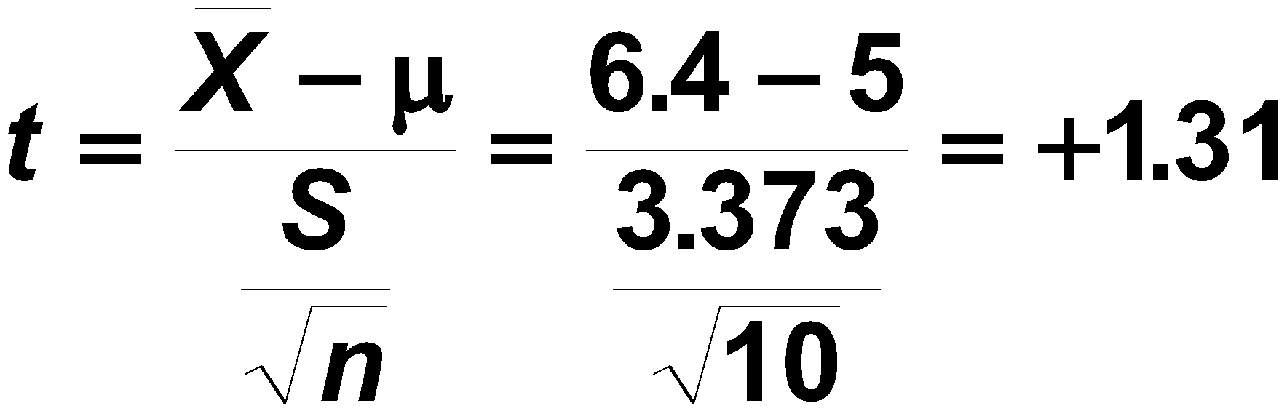
One-Tailed t Test Solution*
H0: μ = 5
Ha: μ > 5
α = .05
df = 10 - 1 = 9
Critical Value(s):
Test Statistic:
Decision:
Conclusion:
Notes:
Note: More than 5 have been sold (6.4), but not enough to be significant.

Slide 191
One-Tailed t Test Solution*
H0: μ = 5
Ha: μ > 5
α = .05
df = 10 - 1 = 9
Critical Value(s):
Test Statistic:
Decision:
Conclusion:
Do not reject at α = .05
Notes:
Note: More than 5 have been sold (6.4), but not enough to be significant.

Slide 192
One-Tailed t Test Solution*
H0: μ = 5
Ha: μ > 5
α = .05
df = 10 - 1 = 9
Critical Value(s):
Test Statistic:
Decision:
Conclusion:
Do not reject at α = .05
There is no evidence average is more than 5
Notes:
Note: More than 5 have been sold (6.4), but not enough to be significant.

Slide 193
Calculating Type II Error Probabilities
Notes:
9

Slide 194
Power of Test
1. Probability of Rejecting False H₀
Correct Decision
2. Designated 1 - β
3. Used in Determining Test Adequacy
4. Affected by
True Value of Population Parameter
Significance Level α
Standard Deviation & Sample Size n

Slide 195
Finding Power Step 1
σ/√n = 15/√25
Reject
①
Hypothesis: H₀: μ₀ ≥ 368 H₁: μ₀ < 368
Do Not
Draw
Reject
α = .05
μ
= 368

0
X

Slide 196
Finding Power Steps 2 & 3
σ/√n = 15/√25
Reject
①
Hypothesis: H₀: μ₀ ≥ 368 H₁: μ₀ < 368
Do Not
Draw
Reject
α = .05
μ
= 368

0
X
‘True’ Situation: μ₁ = 360
③
Draw
②
β
1-β
Specify

μ
= 360
X
1

Slide 197

Finding Power Step 4
σ/√n = 15/√25
Reject
①
Hypothesis: H₀: μ₀ ≥ 368 H₁: μ₀ < 368
Do Not
Draw
Reject
α = .05
μ
= 368

0
X
‘True’ Situation: μ₁ = 360
③
Draw
②
④
Specify

μ
= 360
363.065
X
1

Slide 198
Finding Power Step 5
σ/√n = 15/√25
Reject
①
Hypothesis: H₀: μ₀ ≥ 368 H₁: μ₀ < 368
Do Not
Draw
Reject
α = .05
μ
= 368

0
X
‘True’ Situation: μ₁ = 360
③
Draw
β = .154
④
②
⑤
Specify
Z Table
1-β =.846

μ
= 360
363.065
X
1

Slide 199
Power Curves
H₀: μ ≤ μ₀
H₀: μ ≥ μ₀
Power
Power
Possible True Values for μ₁
Possible True Values for μ₁
H₀: μ = μ₀
Power
μ₀ = 368 in Example
Possible True Values for μ₁

Slide 200
Conclusion
1. Distinguished Types of Hypotheses
2. Described Hypothesis Testing Process
3. Explained p-Value Concept
4. Solved Hypothesis Testing Problems Based on a Single Sample
5. Explained Power of a Test
Notes:
As a result of this class, you will be able to ...

Slide 201
End of Chapter
Any blank slides that follow are blank intentionally.

